Slide 1
The anzac desert champions
GUY HAYDON AND
MIDNIGHT
Notes:
http://www.haydonhorsestud.com.au/news/midnight-the-full-story/

Slide 2
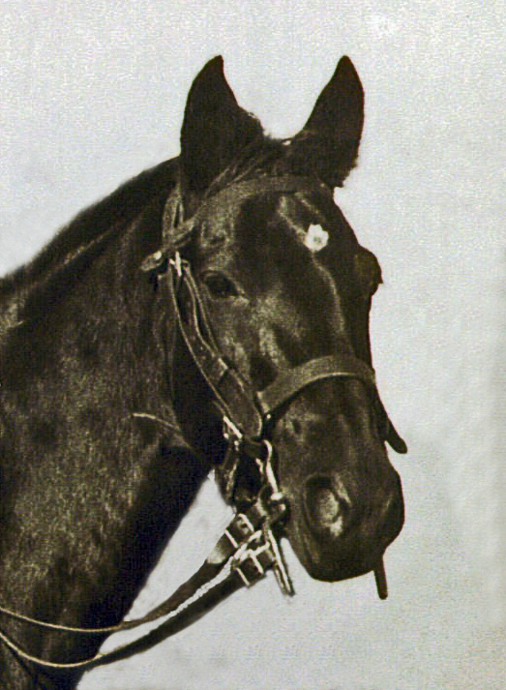
Midnight
Notes:
https://theflyingshetlands.wordpress.com/2016/04/09/midnight-the-story-of-a-light-horse-tells-a-story-of-war-horses-in-a-part-of-world-war-i/

Slide 3
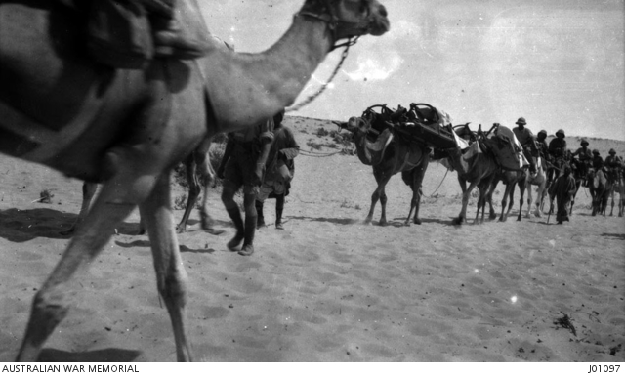
Harsh desert conditions
Horses returning to base in the Sinai
Injured carried on camels
Notes:
Troops returning to Romani https://www.awm.gov.au/collection/J06076
Injured on camels Romani https://www.awm.gov.au/collection/J01097

Slide 4
The haydon logo
The H is branded on the horses as their distinguishing mark
Notes:
http://www.haydonhorsestud.com.au/

Slide 5
The dEsert Olympics
A competition to decide if the British or the ANZACs were the better horsemen. Comprised three events to test the horse, the rider and the combination of both:
1. a sprint
2. an obstacle race
3. dressage
Guy and Midnight won all three events!

Slide 6
The charge at beersheba
October 31 1917 Palestine
Notes:
Disputed picture of the charge at Beersheba (or re-enactment) – Australian War memorial
https://www.awm.gov.au/collection/A02684/. It was probably taken when two regiments of the 4th Brigade, Australian Light Horse, re-enacted the charge for the official photographer Frank Hurley, at Belah on 7 February 1918.

Slide 7
Midnight’s last charge
Painting by Light Horse artist – Jennifer Marshall
www.lighthorseart.com.au
Notes:
Midnight’s Last Charge – painting by Jennifer Marshall www.lighthorseart.com.au

Slide 8
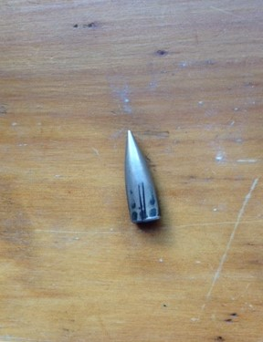
The Fatal bullet
The bullet that killed Midnight
and injured
Guy Haydon
– sent to Guy’s mother for Christmas!
Notes:
The bullet that struck Guy Haydon and Midnight – J Curry

Slide 9
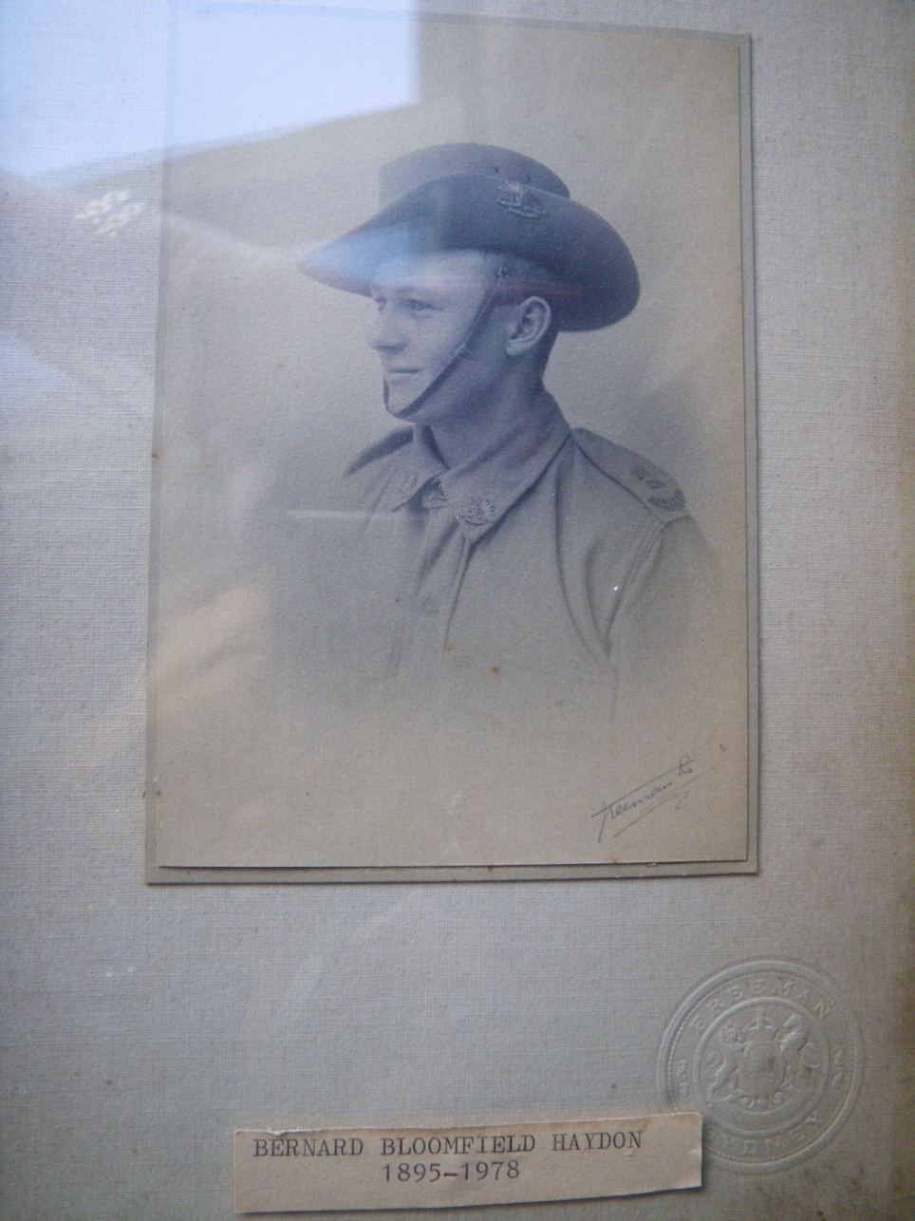
Bernard (Barney) Haydon
Notes:
Barney Haydon from a photograph at the Haydon property – J Curry

Slide 10
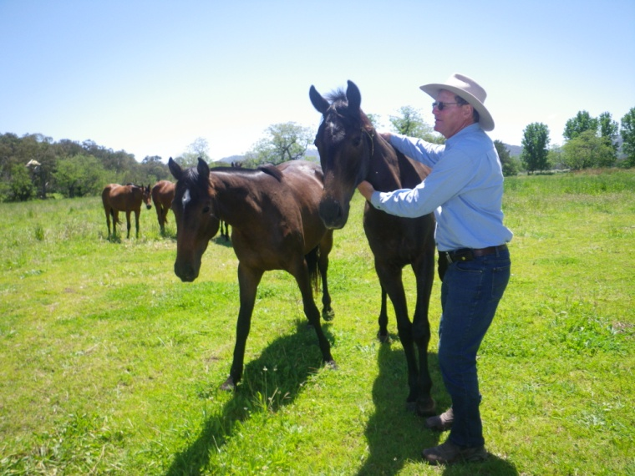
Some of midnight’s descendants
Peter Haydon with ‘War Horse which has very similar markings to Midnight
Notes:
http://www.haydonhorsestud.com.au/
At the Haydon stud – Peter Haydon and War Horse - J Curry

