Slide 1
How young was too young?
Men volunteering for the army were supposed to be 18 but many enlisted much younger.
Harry Bell was one of them.

Slide 2
Notes:
Call from the Dardanelles – Australian War Memorial https://www.awm.gov.au/collection/ARTV05167 Recruitment poster created by H M Burton, for The Defence Department of the Commonwealth

Slide 3
Best Mates – painting by Light Horse Artist Jennifer Marshall
Notes:
Best Mates – Jennifer Marshall http://www.lighthorseart.com.au/Best-Mates.html

Slide 4
Waler with his equipment
Notes:
Taffy & Cpl Edwards – Light Horse WW1 http://www.lighthorseart.com.au/Taffy-Waits/

Slide 5
New Zealand engineers repair well at Khalassa near Beersheba
Notes:
Engineers repairing a well at Khalassa near Beersheba https://www.awm.gov.au/collection/J02836

Slide 6
Abraham’s well at Beersheba
Notes:
Abraham’s well at Beersheba (before renovations) – J Curry

Slide 7
Charge of the Light Horse at Beersheba
Notes:
Disputed picture of the charge at Beersheba (or re-enactment) – Australian War memorial https://www.awm.gov.au/collection/A02684/ It was probably taken when two regiments of the 4th Brigade, Australian Light Horse, re-enacted the charge for the official photographer Frank Hurley, at Belah on 7 February 1918.

Slide 8
Watering horses at Beersheba
Notes:
Watering the horses Beersheba https://www.awm.gov.au/collection/P08548.001

Slide 9
Horse drawn Ambulance wagon
Notes:
Horse drawn Ambulance Wagon https://www.awm.gov.au/collection/B00450

Slide 10
Mass grave for 4th LH casualties
Notes:
Graves at Romani https://www.awm.gov.au/collection/P05693.003

Slide 11
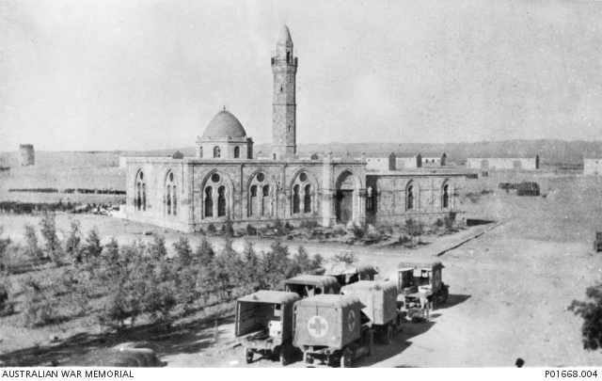
Beersheba after the charge
Notes:
Ambulances outside the Beersheba mosque https://www.awm.gov.au/collection/P01668.004

Slide 12
Beersheba War cemetery today
Notes:
The Commonwealth War Graves cemetery at Beersheba where Harry Bell is buried – J Curry

