Slide 1
Ethnic Groups in the Allied troops
Hong Kong and Singapore battery
Australian Chinese crack shot
Indian infantry and cavalry
Australian Jewish leaders
Zion Mule Corps and Jewish Legion

Slide 2
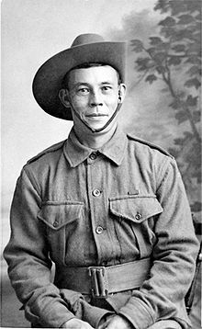
Billy Sing
Crack Shot of the ANZACs
Notes:
Billy Sing – DCM, 5th Light Horse Regiment. Australian War Memorial https://www.awm.gov.au/collection/P03633.006 Gale's Studios Ltd, UK.

Slide 3
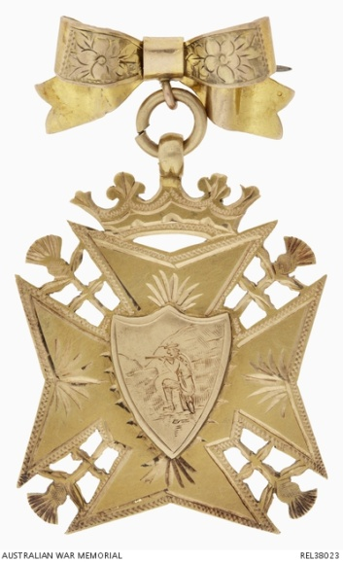
Cross given to Billy Sing – note the sniper in the centre
Notes:
Medallion given to Billy Sing https://www.awm.gov.au/collection/REL38023

Slide 4
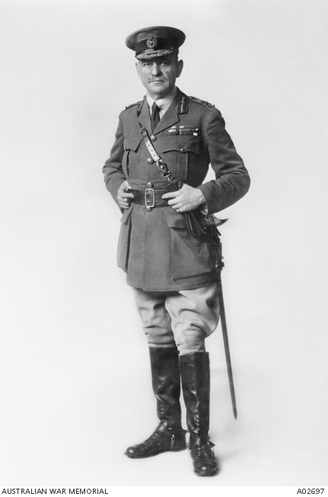
Sir John Monash
Australia’s most famous military commander
Commanded all Australian Troops from May 1918 on the Western Front
Planned and expedited the breakthrough that ended WW1
Notes:
Sir John Monash https://www.awm.gov.au/collection/A02697/

Slide 5
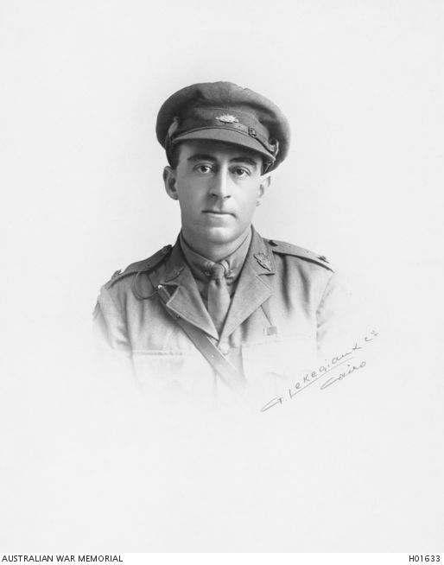
Eric Montague Hyman
Led the ‘A’ Squadron of the 12th Light Horse in the charge at Beersheba
Notes:
Major Eric Hyman https://www.awm.gov.au/collection/H01633/

Slide 6
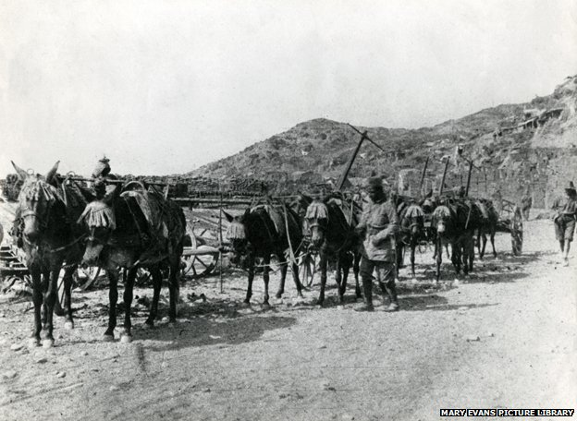
Zion Mule Corps
Notes:
Zion Mule Corps http://www.bbc.com/news/magazine-30248216

Slide 7
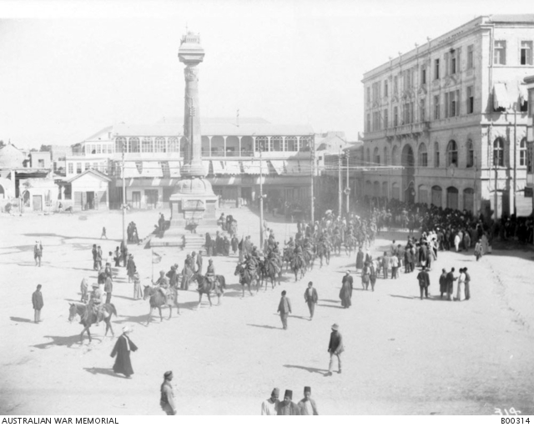
Indian Cavalry enter Damascus
Notes:
Indian cavalry entering Damascus https://www.awm.gov.au/collection/B00314/

