Slide 1
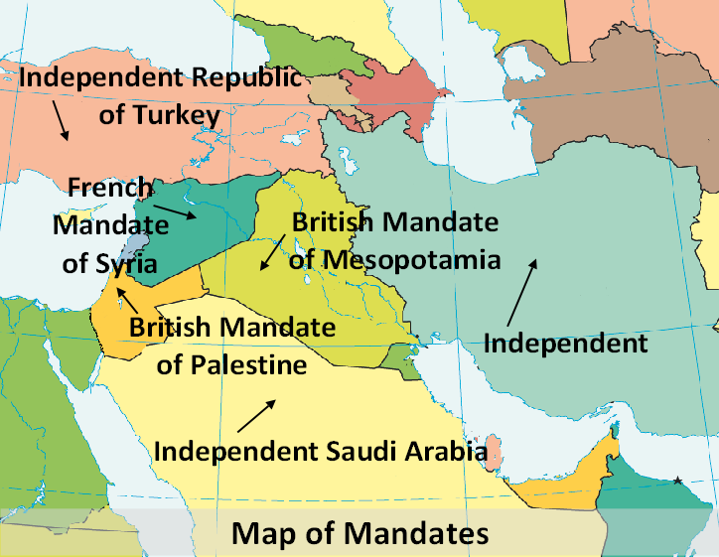
How the Middle East was partitioned
Notes:
Map of mandates – Base map - CIA World Fact Book https://www.cia.gov

Slide 2
League of Nations Mandate – Ratified July1922 San Remo
France – Syria (Syria and Lebanon
Britain - Mesopotamia (Iraq) and Palestine (Jordan and Israel)

Slide 3
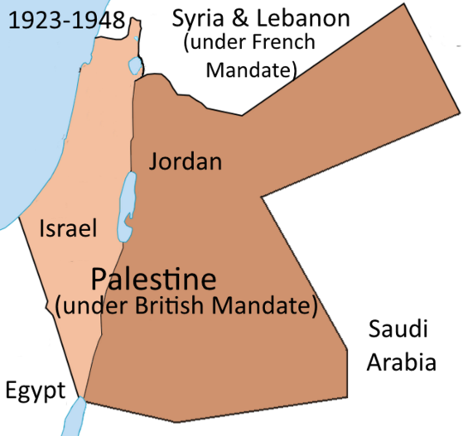
British Mandate over Palestine
Notes:
Map of Partition of Palestine – https://commons.wikimedia.org/wiki/File:PalestineAndTransjordan.png – Doron

Slide 4
How Palestine was divided
Arabs – 77% - Land East of the Jordan River (38,000 square miles). Became Jordan
Jews – 23% - Land West of the Jordan River (8,000 square miles). Became Israel

Slide 5
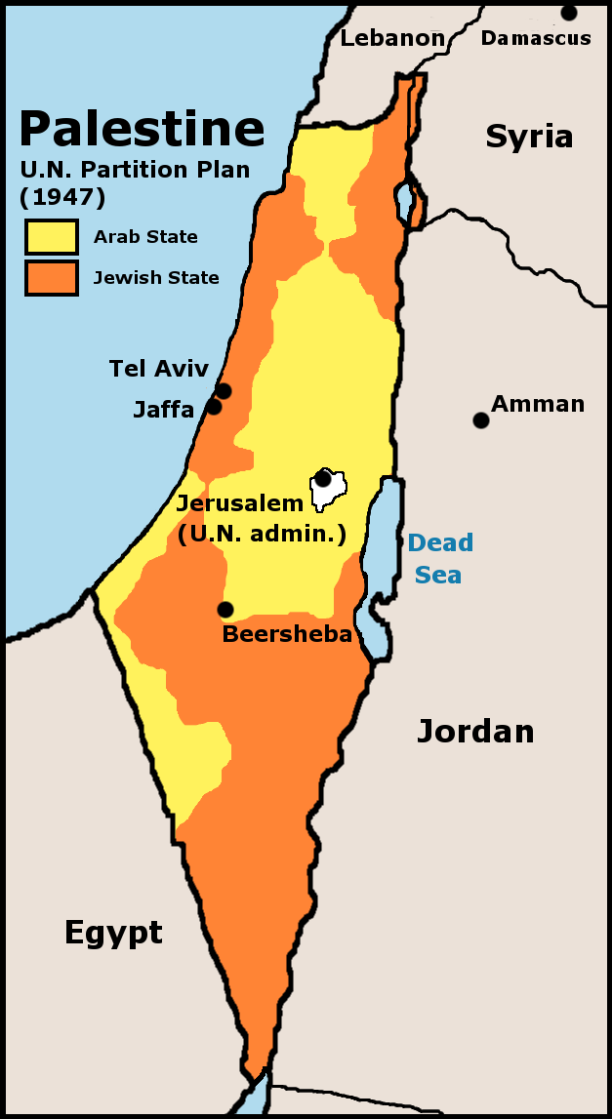
UN Partition Plan 1947
Accepted by Jews
Rejected by all Arab countries
Notes:
http://laopinion2010.blogspot.com.au/p/historia-israel-y-palestina-breve.html

Slide 6
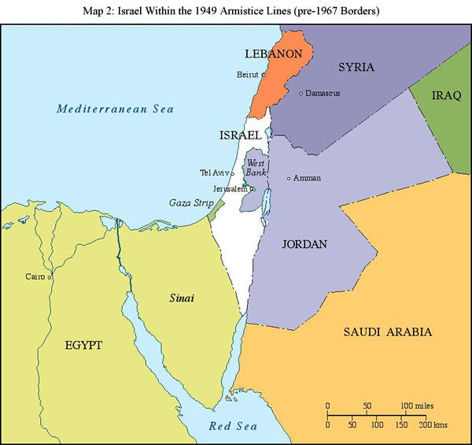
1949-1967 boundaries
Notes:
http://israelvoice.blog.com/2011/06/11/dispatch-from-jerusalem-lets-talk-1967

Slide 7
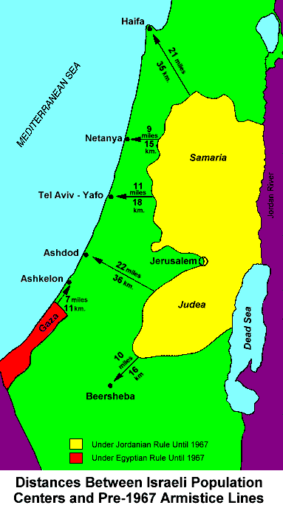
Map showing distances
Notes:
Pre-’67 borders http://anaverageamericanpatriot.blogspot.com.au/2010/12/bolivia-recognizes-palestine-while.html

Slide 8
Significance of the ANZAC contribution to the campaign
The Allied forces caused an Empire to fall & 6 nations to be born. ANZACs often at the forefront.
The ANZACs put Australia and New Zealand on the world map
They created the ANZAC legend

