Slide 1
Bill the Bastard and the Battle of Romani
Diorama of the Battle of Romani Australian War Memorial Canberra
Notes:
Romani Diorama by Wallace Anderson (sculptor) and, Louis McCubbin (painter). Australian War Memorial https://www.awm.gov.au/collection/ART41024/

Slide 2
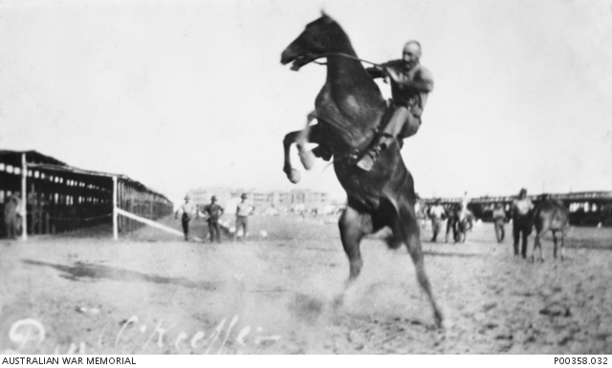
Breaking in the horses
Notes:
Corporal Daniel O’Keeffe of the first Remount Unit. Australian War Memorial https://www.awm.gov.au/collection/P00358.032

Slide 3
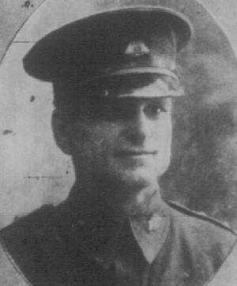
Major Michael Shanahan
Notes:
Michael Shanahan http://alh-research.tripod.com/2nd_light_horse_regiment_aif/ql26091914p23_2ndLH_Officers_SHANAHAN_M_1qaa1.jpg

Slide 4
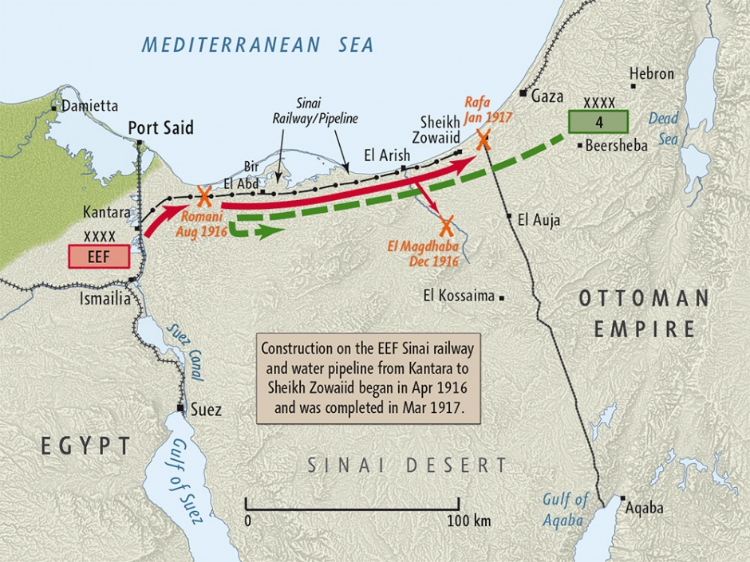
ANZAC troops in the Sinai
Notes:
Map produced by Geographx with research assistance from Damien Fenton and Caroline Lord. Map of 'Sinai campaign 1916 map', http://www.nzhistory.net.nz/media/photo/sinai-campaign-1916-map, (Ministry for Culture and Heritage), updated 14-Aug-2014

Slide 5
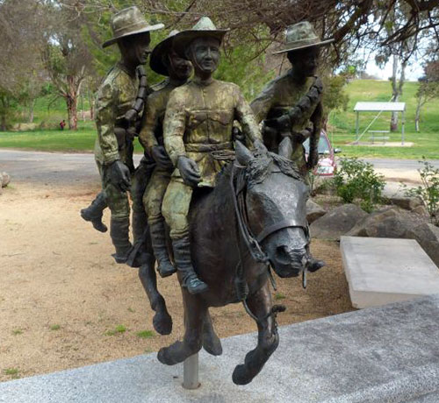
Bill the Bastard statue Murrumburrah, NSW
Notes:
Carl Valerius' statue of Bill the Bastard, Murrumburrah, NSW, Australia – http://iwvpa.net/clifford-m/bill-the-.php

Slide 6
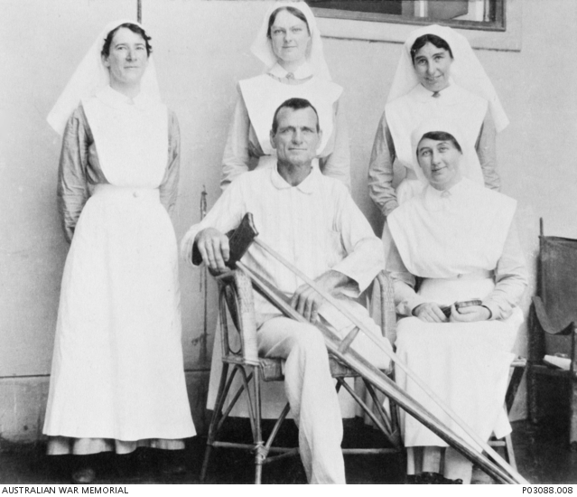
Michael Shanahan in hospital
Notes:
Michael Shanahan in hospital – https://www.awm.gov.au/collection/P03088.008. 2nd Australian Light Horse, Cairo Sept 1916

Slide 7
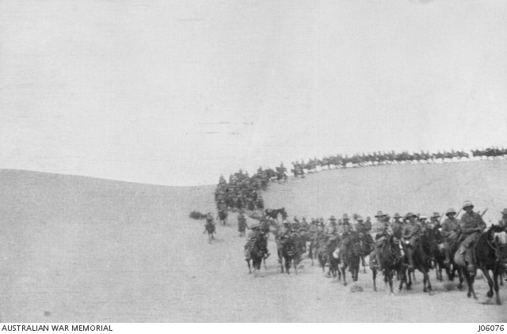
Returning to Romani
The Allied troops lost 202 men, mostly ANZACs.
The Turkish toll was 1,250 killed, almost 4,000 injured and another 4,000 captured.
Notes:
Returning to Romani from Katia. Australian War Memorial https://www.awm.gov.au/collection/J06076/

Slide 8
ANZAC success
British commander, Sir Archibald Murray called the ANZACs, “the keystone of the defence of Egypt”
The ANZACs were then put on the frontline of the battle through the Sinai
Turned the British thinking from defence of the Suez to ‘get Jerusalem’
First time the Turkish armies were defeated

Slide 9
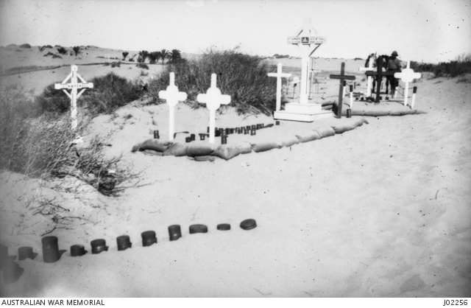
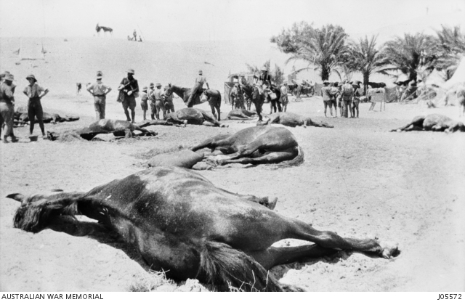
...but always at a cost
For men
and for horses
Notes:
Graves at Romani – Australian War Memorial https://www.awm.gov.au/collection/J02256/;
Horses of the 2nd Light Horse regiment killed by bomber aircraft at Romani. Australian war Memorial - https://www.awm.gov.au/collection/J05572/

Slide 10
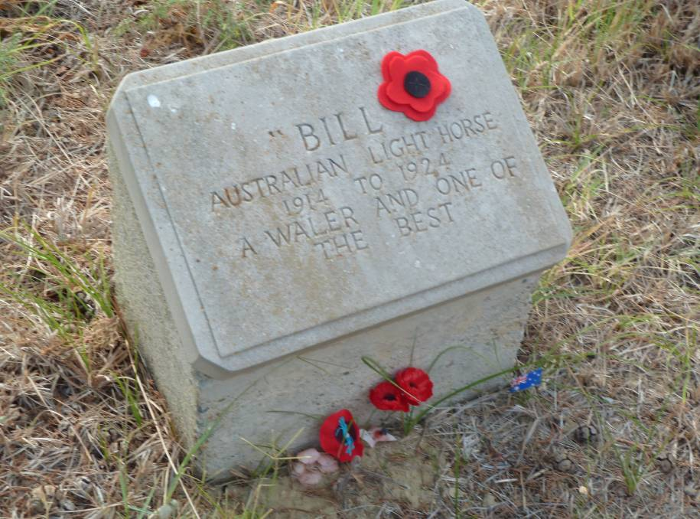
Bill’s grave at Gallipoli
Notes:
Bill the Bastard's grave at Gallipoli between two pine trees below Walker's Ridge. Picture: Anne Flood http://www.hardenexpress.com.au/story/4073524/romani-an-historic-victory-videos-photos/

