Slide 1
Anzac values
Notes:
$1 coin http://www.australian-coins.com/complete-guide-australian-1-dollar-1-coins/2015-100-years-anzac-circulating-dollar/

Slide 2
Spirit of the digger – Patrick lindsay
“Chief among these [ANZAC] qualities are mateship, courage, compassion, endurance, selflessness, loyalty, resourcefulness, devotion, independence, ingenuity, audacity, coolness, larrikinism and humour.”
Notes:
Lindsay, P., The Spirit of the Digger, Harper Collins, 2003, Page 16

Slide 3
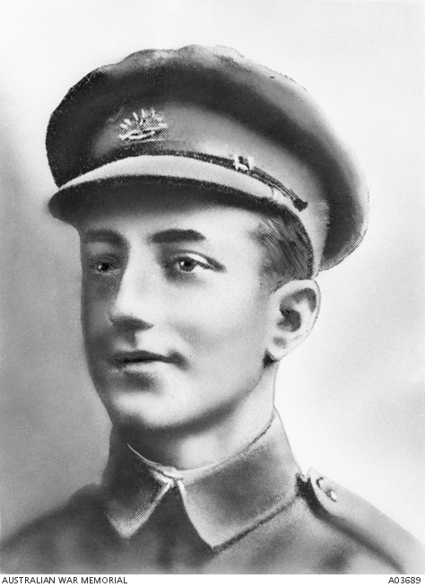
FRANK MCNAMARA – VC WINNER
MATESHIP
Notes:
Frank McNamara – Australian War Memorial, https://www.awm.gov.au/collection/A03689/

Slide 4
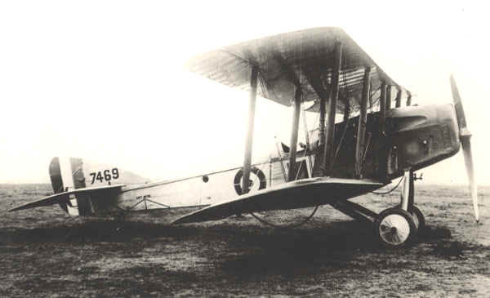
World War 1 Martinsyde aircraft
Notes:
http://www.stevebusterjohnson.com/6-sqn-aircraft

Slide 5
Charge of the Light Horsemen
Madmen with reckless courage
Notes:
Disputed picture of the charge at Beersheba (or re-enactment) – Australian War memorial https://www.awm.gov.au/collection/A02684/ It was probably taken when two regiments of the 4th Brigade, Australian Light Horse, re-enacted the charge for the official photographer Frank Hurley, at Belah on 7 February 1918.

Slide 6
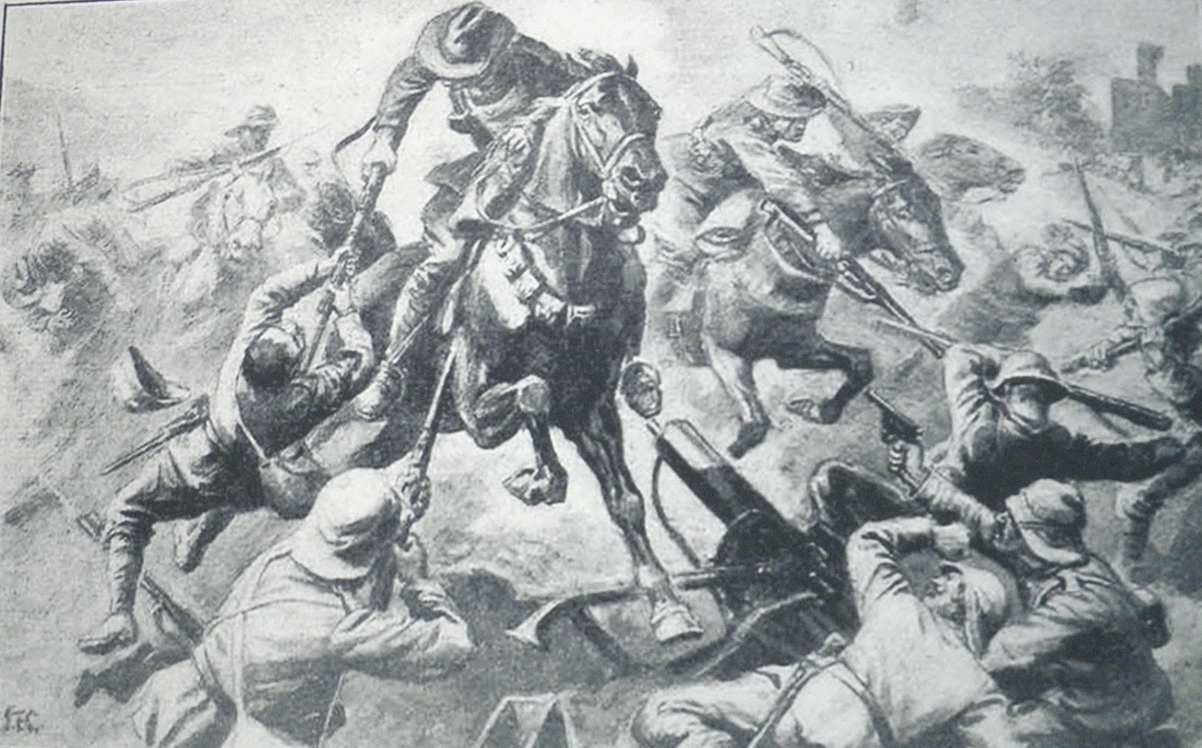
Jumping the trenches
Notes:
Jumping the trenches – from a photograph at an exhibition in Beersheba in 2012

Slide 7
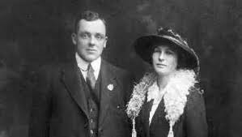
‘SCOTTY’ BOLTON – DCM - COURAGE
Scotty and Elsie on their Wedding Day
Notes:
Scotty and Elsie wedding photo https://anzacday.org.au/trooper-sloan-scotty-bolton-dcm

Slide 8
Captured turkish guns
Notes:
Captured Turkish artillery at Beersheba. Australian War Memorial https://www.awm.gov.au/collection/H01373/

Slide 9
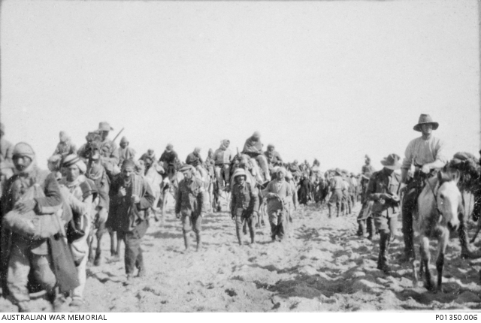
10th LH with turkish prisoners
Maghdaba December 1916
Notes:
10th LH with 1400 Turkish prisoners from Maghdaba https://www.awm.gov.au/collection/P01350.006

Slide 10
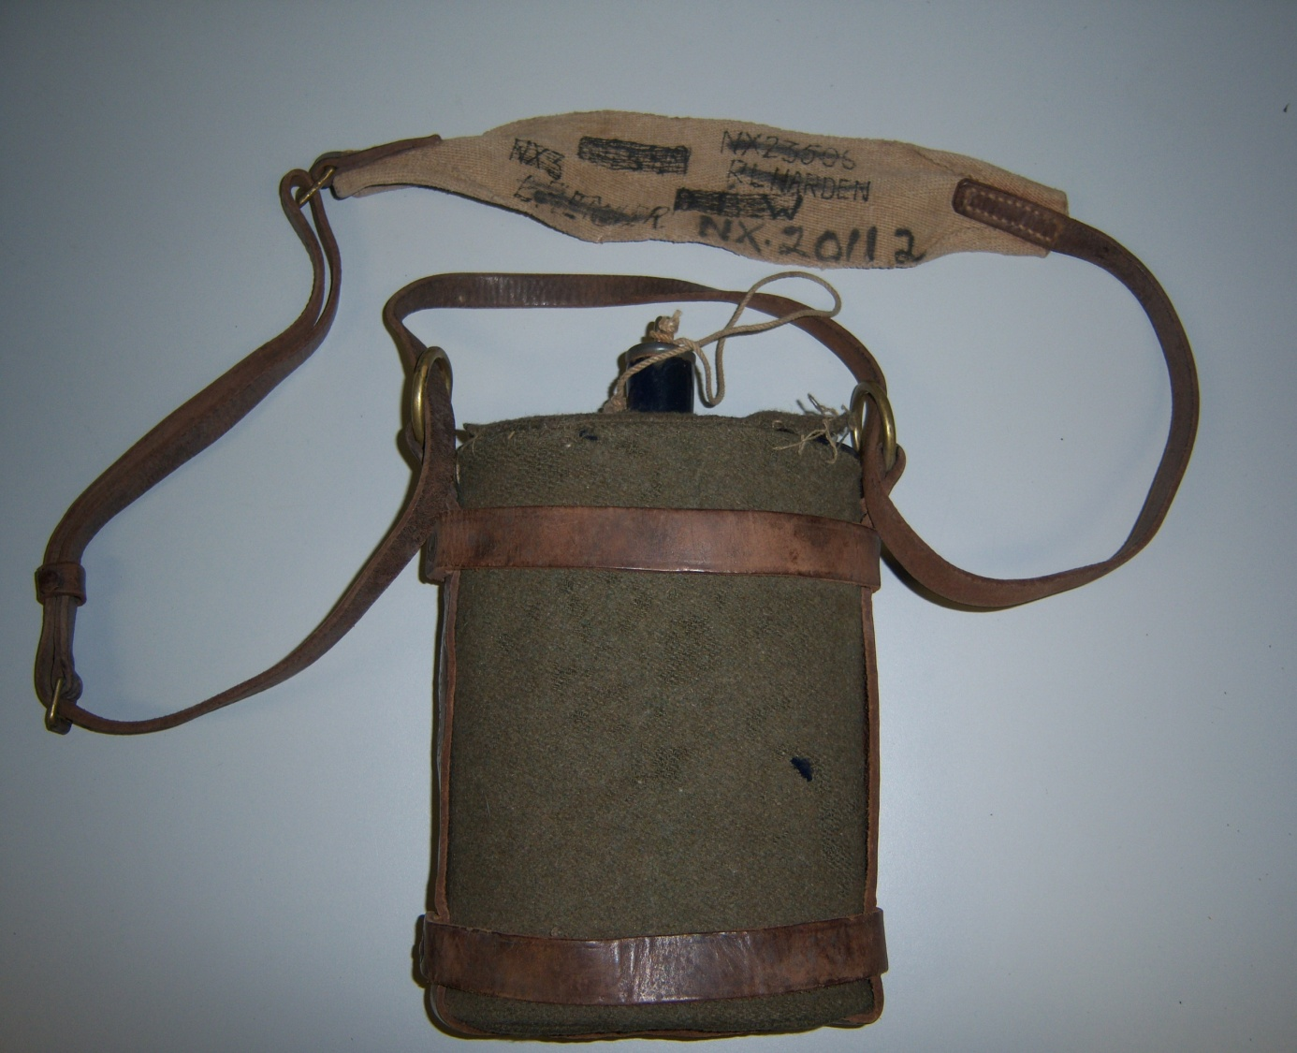
Water ration for a day
Notes:
http://medalsgonemissing.com/military-medal-blog/military-memorabilia/the-21st-lighthorse-and-an-03-pattern-waterbottle/

Slide 11
Endurance in the desert
Notes:
Dead Horses at Romani Australian War Memorial https://www.awm.gov.au/collection/J05572/

Slide 12
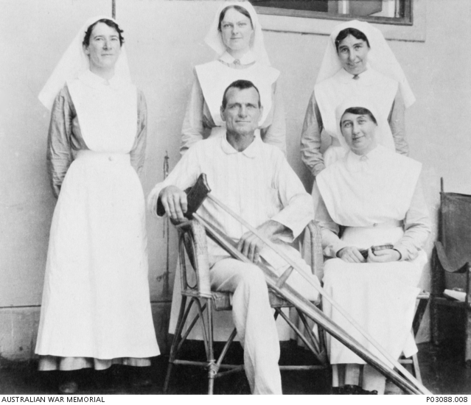
Michael shanahan - dcm
Notes:
Michael Shanahan in hospital – https://www.awm.gov.au/collection/P03088.008. 2nd Australian Light Horse, Cairo Sept 1916

