Slide 1
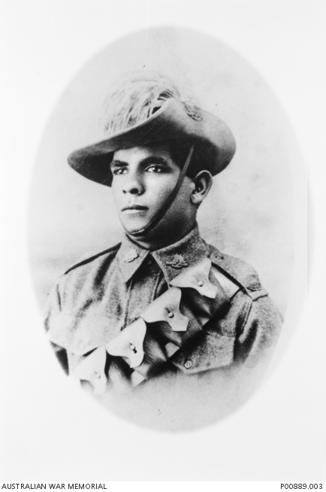
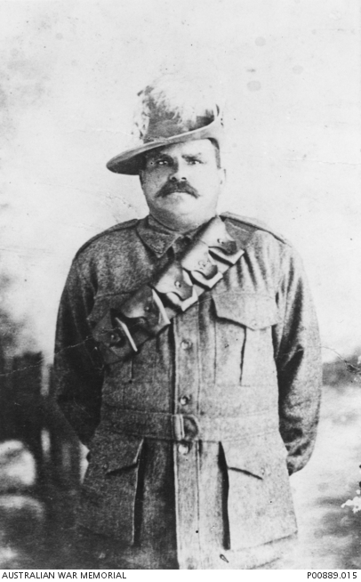
Aborigines in the Light Horse
Notes:
Horace Thomas Dalton, 11th Light Horse Regiment https://www.awm.gov.au/collection/P00889.003;
Frank Fisher, 11th Light Horse regiment was a well-known Rugby player and Cathy Freeman’s great-grandfather. https://www.awm.gov.au/collection/P00889.015

Slide 2
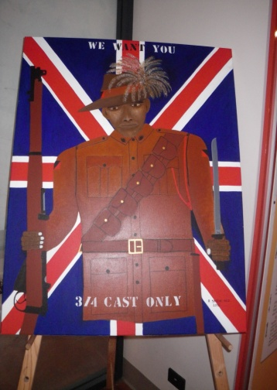
Painting by R Synon – Townsville Cultural Centre
Notes:
Painting by indigenous artist R. Syron, Townsville Cultural Centre – Jill Curry.

Slide 3
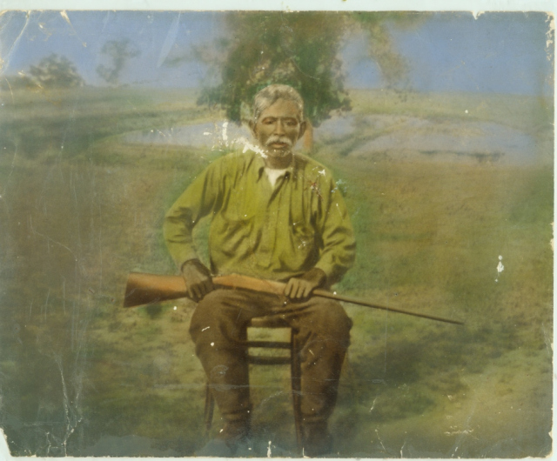
Charles Alley Senior
Notes:
Charles Alley senior. Courtesy Alley family, on the website https://indigenoushistories.com/2015/04/15/charlie-alley-light-horseman-the-service-tradition-of-the-alley-family/

Slide 4
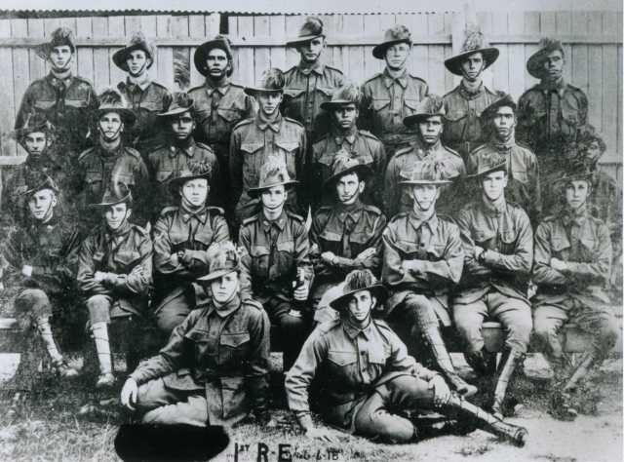
The ‘Queensland Black Watch’
Notes:
Ist Reinforcements Egypt. June 1918. The photograph contains at least seven Aboriginal men although names cannot be linked to specific individuals. It is possible that Charlie Alley may be one of their number. Too Dark for the Light Horse Collection. Courtesy David Huggonson. Website: https://indigenoushistories.com/2015/04/15/charlie-alley-light-horseman-the-service-tradition-of-the-alley-family/

Slide 5
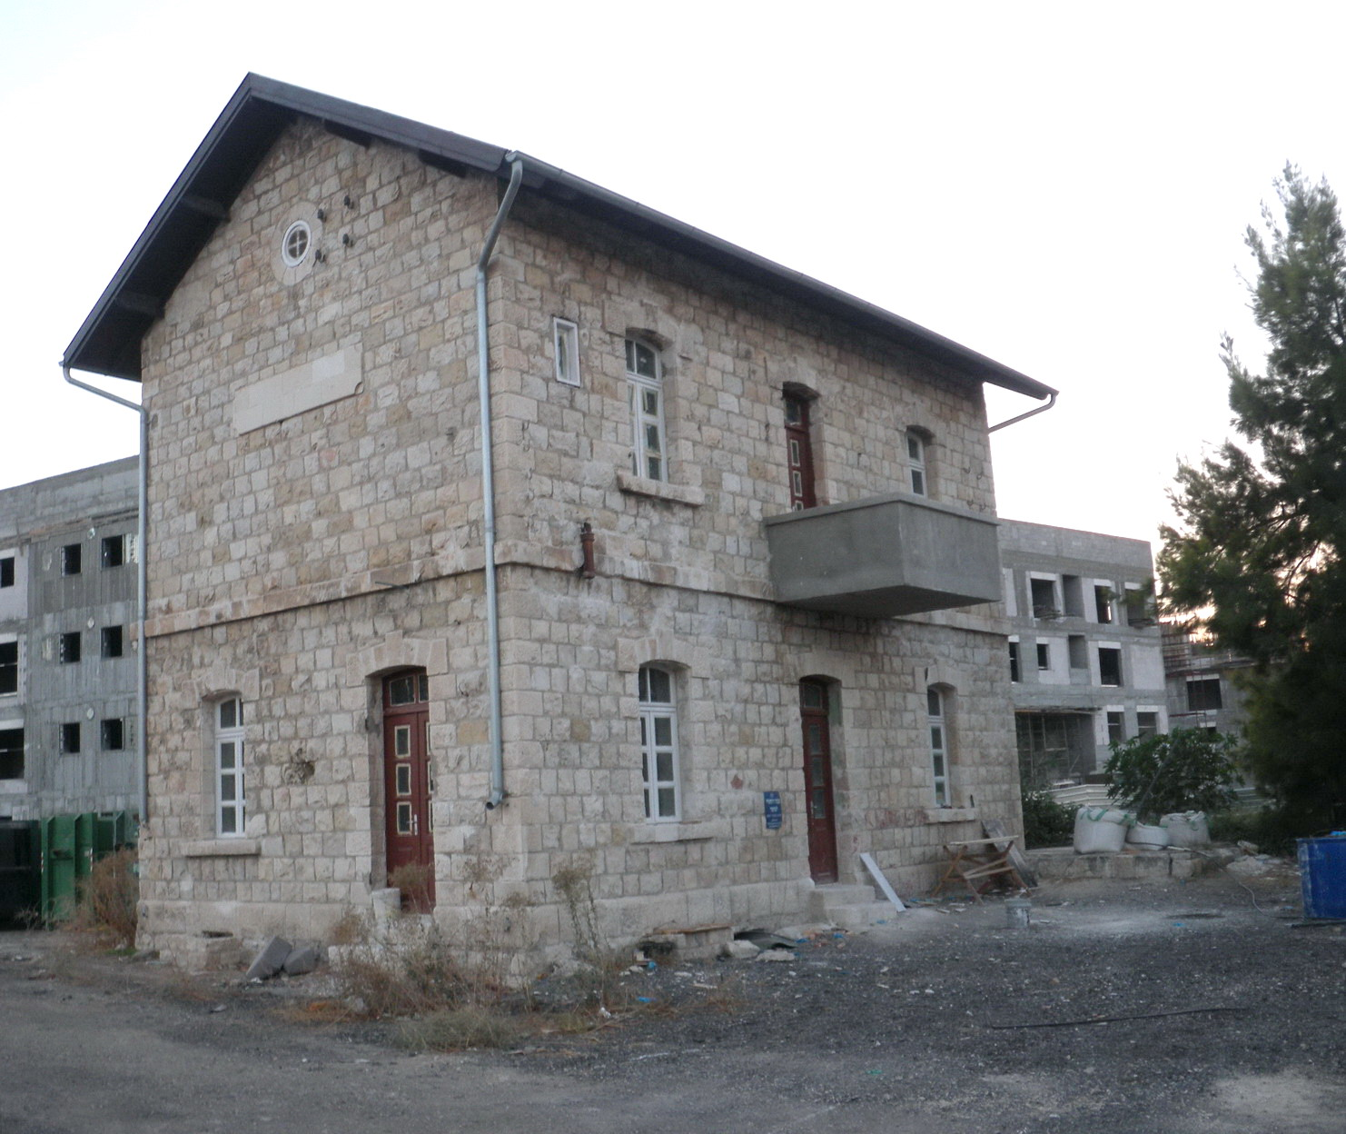
Semakh Station – partially restored
Notes:
Semakh Railway Station partially restored – J Curry

Slide 6
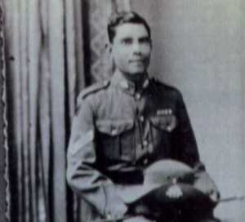
Charlie Alley in World War 2 uniform
Notes:
Charlie Alley, World War Two. He wears his World War One service ribbons in this photograph. Courtesy Mrs Mavis Blackman. https://indigenoushistories.com/2015/04/15/charlie-alley-light-horseman-the-service-tradition-of-the-alley-family/

