Slide 1
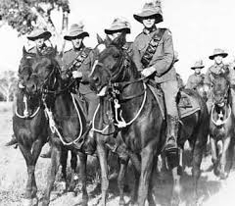
A Tale of Three Cities
Beersheba
Jerusalem
Damascus
Notes:
http://clangrantaus.com/australia/australian-military-history/australian-lighthorse/

Slide 2
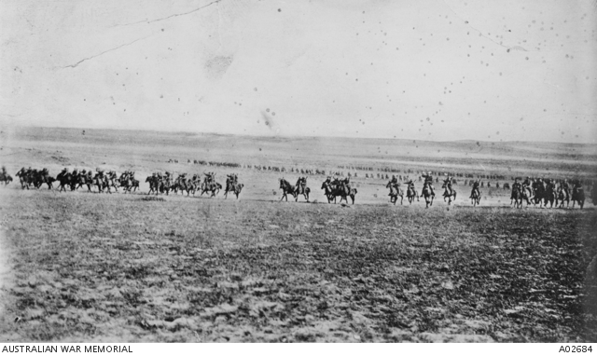
The Last Great Cavalry Charge in History
Notes:
Disputed picture of the charge at Beersheba (or re-enactment) – Australian War memorial https://www.awm.gov.au/collection/A02684/ It was probably taken when two regiments of the 4th Brigade, Australian Light Horse, re-enacted the charge for the official photographer Frank Hurley, at Belah on 7 February 1918.

Slide 3
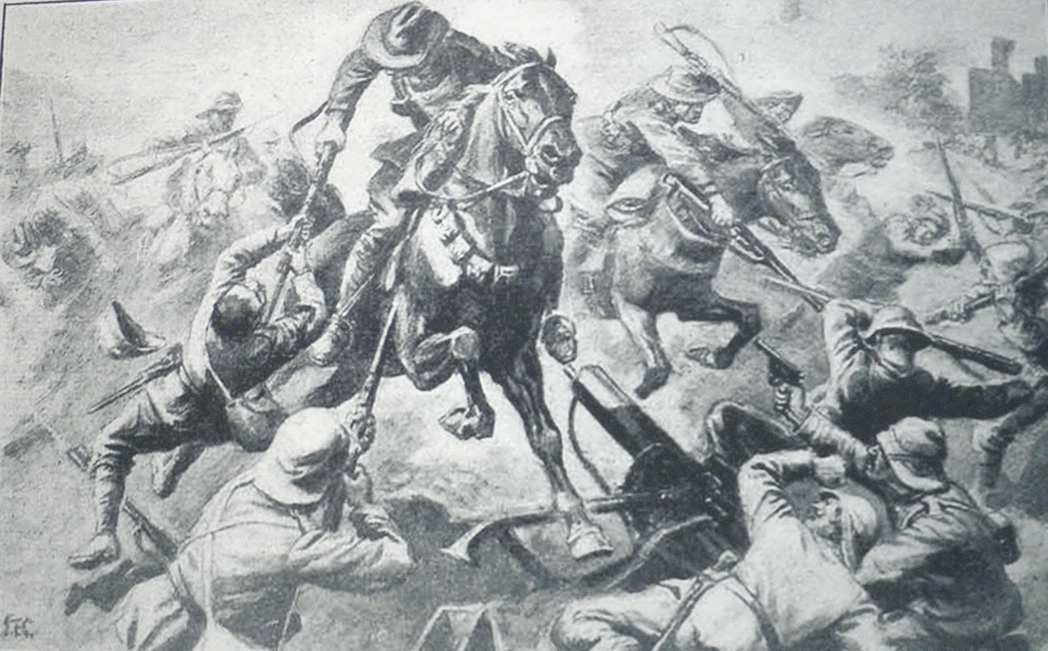
Jumping the Trenches
Notes:
Jumping the trenches – from a photograph at an exhibition in Beersheba in 2012

Slide 4
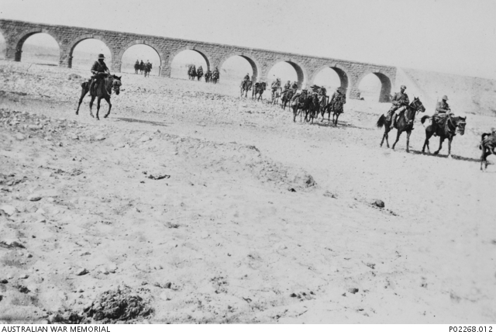
Under the Railway Bridge - Beersheba
Notes:
4th Light Horse Brigade near the railway bridge at Beersheba. Australian War Memorial https://www.awm.gov.au/collection/P02268.012

Slide 5
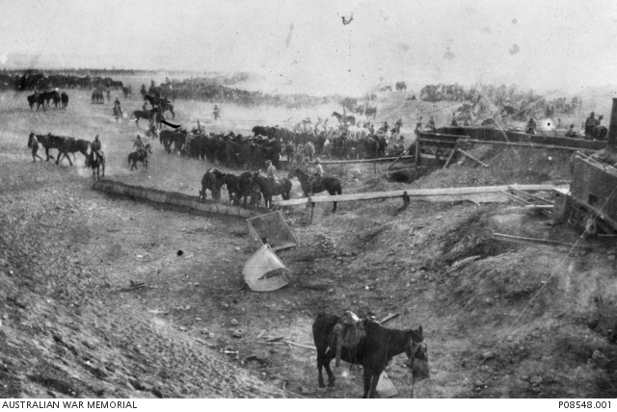
Watering the horses
Notes:
Watering the horses at Beersheba - https://www.awm.gov.au/collection/P08548.001

Slide 6
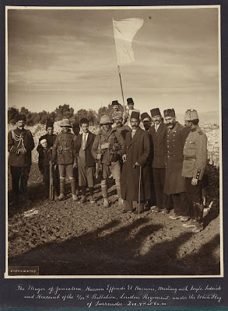
The Unofficial Surrender of Jerusalem – December 9
1917
Notes:
http://www.israeldailypicture.com/2011/09/surrender-of-jerusalem-to-british.html The caption below reads: "The Mayor of Jerusalem Hussein Effendi El Husseini meeting with Srgts Sedwick and Hurcomb, 2/19th Battalion, London Regiment, under the White Flag of Surrender, December 9th at 8 a.m." Photo by Lewis Larsson. The British officials did not want this photo released but it has survived.

Slide 7
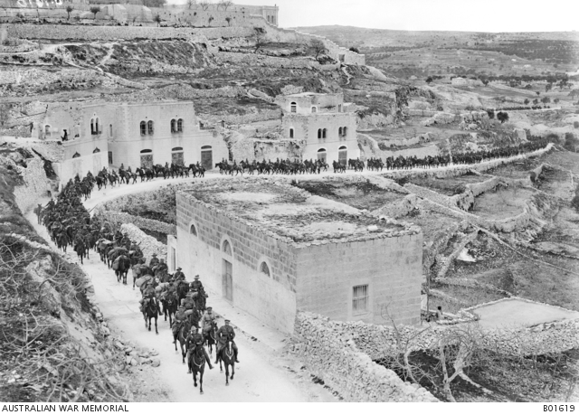
Light Horse troops entering Jerusalem
Notes:
Light Horse marching to Jerusalem - https://www.awm.gov.au/collection/B01619 Photo by Frank Hurley

Slide 8
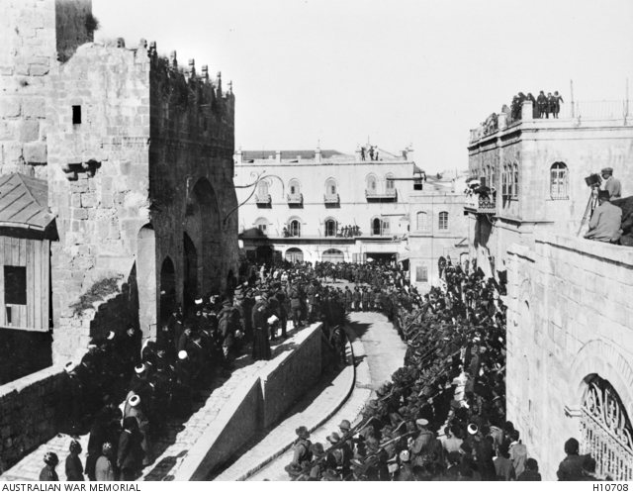
The Official Surrender – December 11
Notes:
The official surrender of Jerusalem - https://www.awm.gov.au/collection/H10708

Slide 9
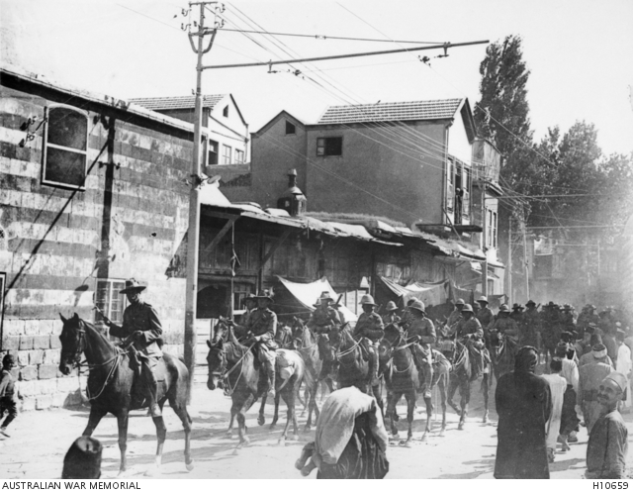
Australian Troops in Damascus
Notes:
Chauvel leads his men through Damascus https://www.awm.gov.au/collection/H10659/

Slide 10
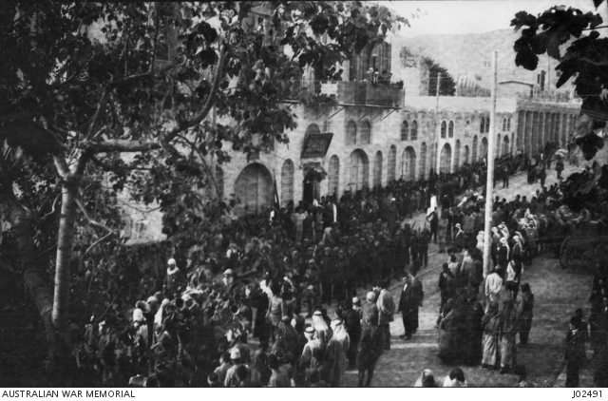
Arabs arrive for official surrender of Damascus
Notes:
https://www.awm.gov.au/collection/J02491

