Slide 1
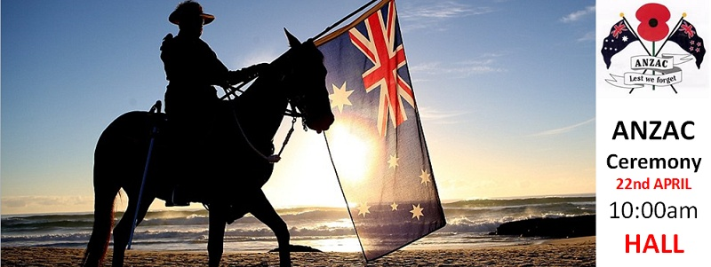
ANZACs and AUSTRALIAN IDENTITY
Notes:
http://epublisher.net.au/public/subscriber/contactlists/archiveissuewebversionwithads?issueId=mMXrvVOZEgKuGPmku2Qa9uLYIIGQtJgfdQFnSAmZSnI

Slide 2
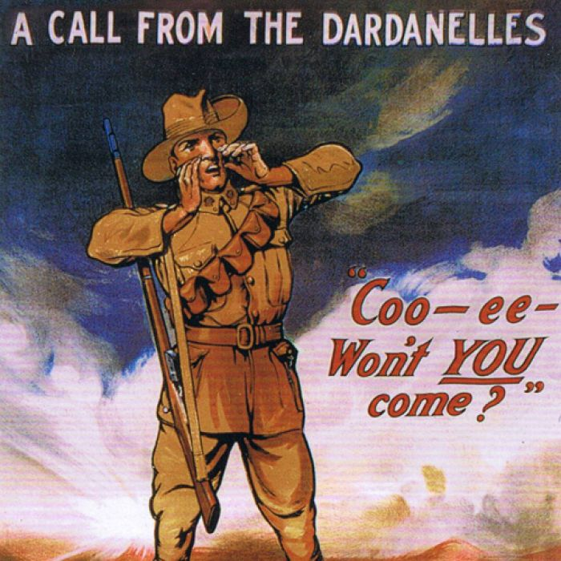
The Toll of World War 1
416,809 men voluntarily enlisted
332,000 served overseas.
Over 60,000 died
156,000 were wounded, taken prisoner or gassed.
Notes:
Call from the Dardanelles – Australian War Memorial https://www.awm.gov.au/collection/ARTV05167 Recruitment poster created by H M Burton, for The Defence Department of the Commonwealth

Slide 3
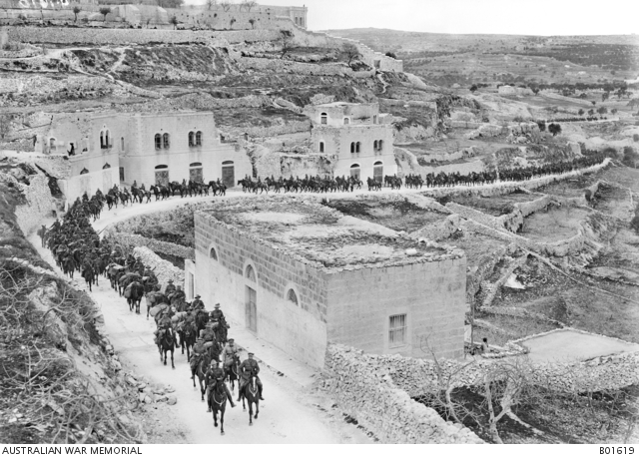
Sinai, Palestine and Syria
32,000 men and 40,000 horses participated in the Palestinian campaign
1,394 died from injuries or disease and 4,851 were wounded.
Notes:
Light Horse on the march to Jerusalem https://www.awm.gov.au/collection/B01619 Photo by Frank Hurley

Slide 4
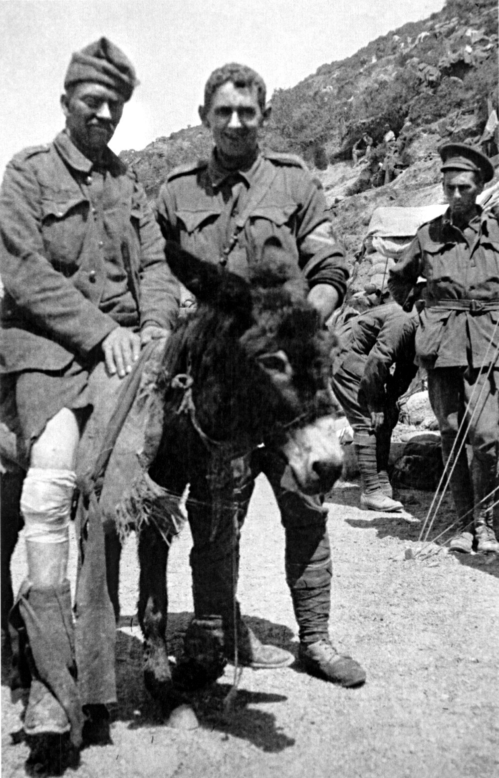
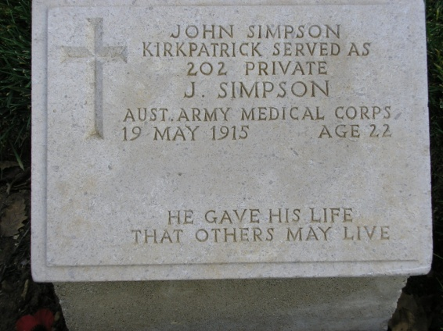
Sacrifice – John Simpson
Notes:
Simpson and his donkey http://teganbrunton.weebly.com/simpson-and-his-donkey.html
Simpson’s grave at Gallipoli – J Curry

Slide 5
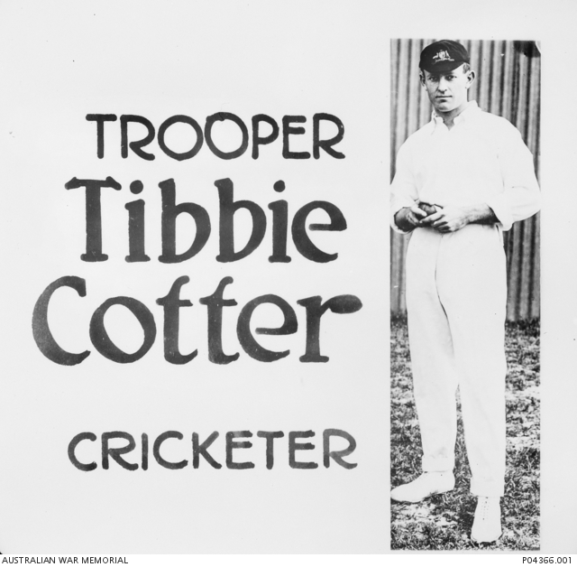
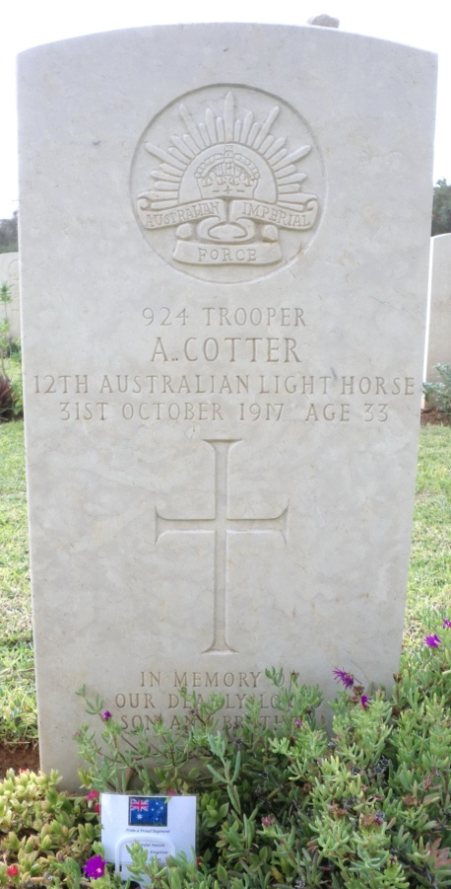
Tibbie Cotter – Aust cricketer
Cotter died at the Battle of Beersheba
Notes:
Albert ‘Tibbie’ Cotter – Stretcher bearer with the 12th Light Horse Regiment. Australian War Memorial Photo https://www.awm.gov.au/collection/P04366.001 Photo by Linton Slide.
Cotter’s grave at Beersheba – J. Curry

Slide 6
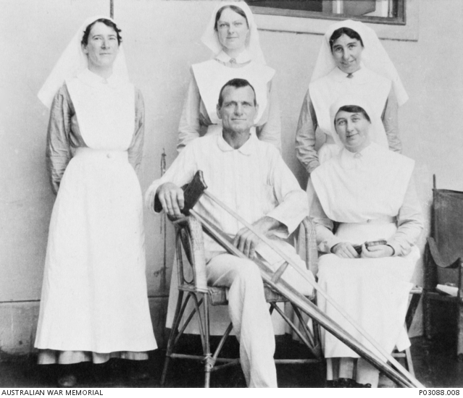
Michael Shanahan lost a leg
Many of those who did return came home with physical, mental or emotional scars that remained with them for the rest of their lives.
Notes:
Michael Shanahan in hospital – https://www.awm.gov.au/collection/P03088.008. 2nd Australian Light Horse, Cairo Sept 1916

Slide 7
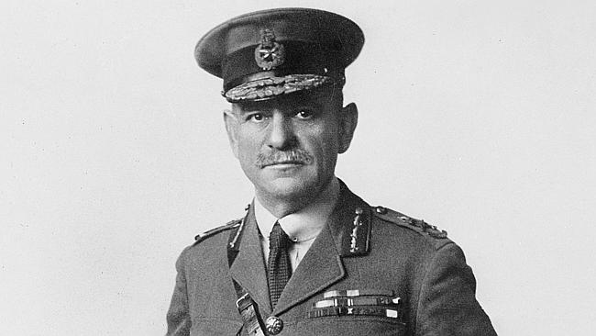
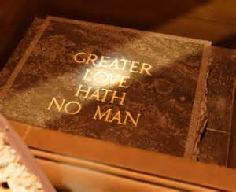
Lt Gen Sir John Monash
Vice Chancellor of the University of Melbourne
Head of the State Electricity Commission (he was an engineer)
Founding member of the first Rotary Club of Melbourne
President of the Zionist Federation of Australia
Organised the planning of the Shrine of Remembrance
Notes:
Lt Gen Sir John Monash – Australian War Memorial photo - cropped. Portrait photo by Swaine. https://www.awm.gov.au/collection/A02697/;
Stone of Remembrance at the Shrine, Melbourne http://www.shrine.org.au/ At 11am on 11/11 each year the sun shines on the word ‘Love’.

Slide 8
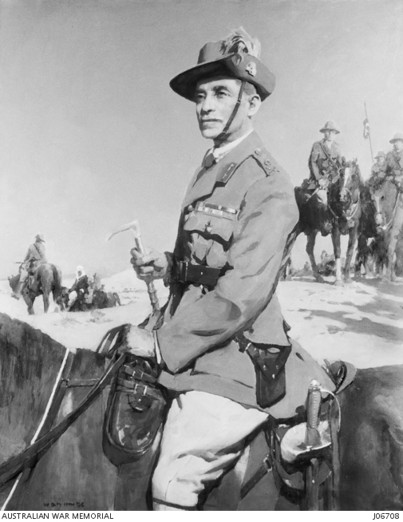
Sir Harry Chauvel
Appointed Inspector General – the nation’s top army position
Campaigned for veterans causes
On the committees for the Australian and Victorian War Memorials, the Red Cross and Young Men’s Christian Association.
Notes:
Sir Harry Chauvel. Portrait by McInnis. Australian War Memorial https://www.awm.gov.au/collection/J06708/

Slide 9
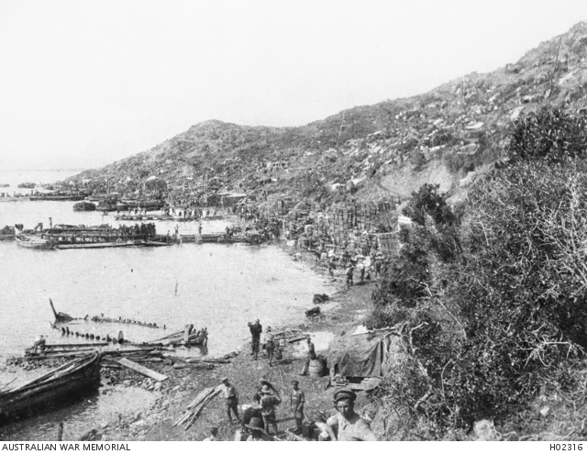
Monash
“It was on this day, seven years ago, just as day was breaking, that the soldiers of Australia and New Zealand stormed the beetling cliffs of Gallipoli, and in so doing, founded the tradition of the Australian nation”. – Monash 1922
Notes:
ANZAC Cove https://www.awm.gov.au/collection/H02316/

Slide 10
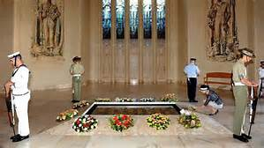
Paul Keating
“It is a legend not of sweeping military victories so much as triumphs against the odds, of courage and ingenuity in adversity.
It is a legend of free and independent spirits whose discipline derived less from military formalities and customs than from the bonds of mateship and the demands of necessity.”
Notes:
Tomb of the Unknown Soldier http://www.smh.com.au/act-news/known-unto-god-to-remain-at-tomb-of-unknown-soldier-at-war-memorial-20131028-2wcnj;
Quote from http://www.australia.gov.au/about-australia/australian-story/anzac-day

Slide 11
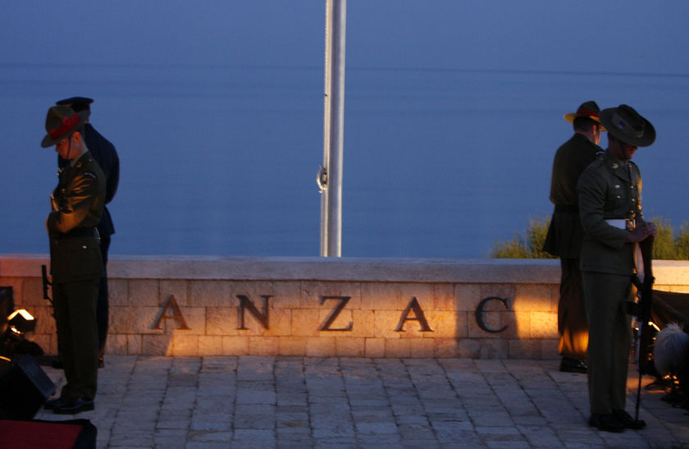
Tony Abbott
“Today, we do not glorify war but honour the values the Anzacs embodied in the most trying of circumstances. .. the worst of times brought out the best in them – extraordinary courage, perseverance... and selflessness...
In the magnificent failure at Gallipoli, the successful advances in the Middle East and the terrible victory on the Western Front, our soldiers embodied the commitment to freedom, the spirit of adventure and the bonds of mateship that we hold dear to this day. Their values helped to forge our nation’s identity.”
Notes:
http://www.theaustralian.com.au/in-depth/anzac-day/tony-abbott-anzac-values-forged-our-identity-at-gallipoli/news-story/062c6cc7efef610cefe03bb37170c2d6;
http://www.backpackerstravel.net/Anzac-Day-6-days-Turkey-Tour-kod5-tid10-turid72-backpackersmenu6876435897436

Slide 12
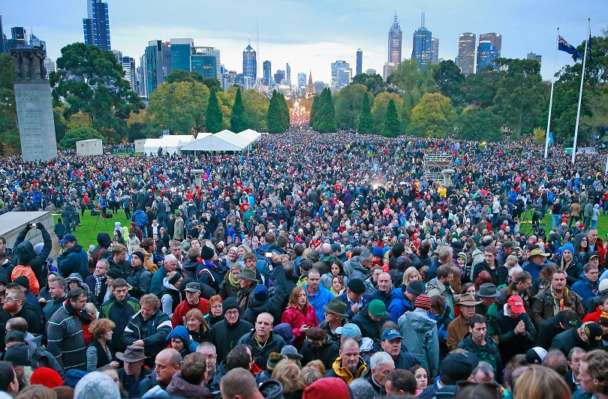
ANZAC Day crowds
Notes:
http://www.businessinsider.com.au/27-beautiful-images-of-anzac-day-dawn-services-from-across-the-country-2015-4#Sydney1

Slide 13
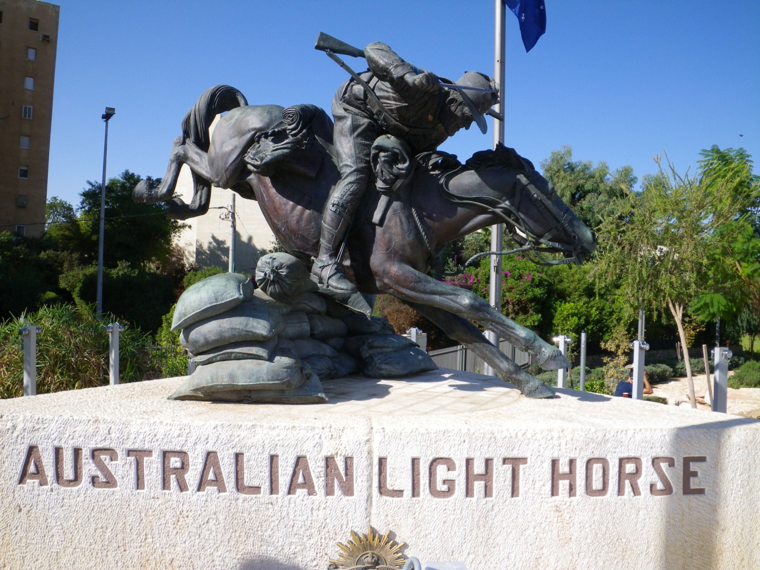
Light Horse statue – Be’er Sheva
Notes:
Peter Corlett’s Light Horse statue, Park of the Australian Soldier, Be’er Sheva – Jill Curry

Slide 14
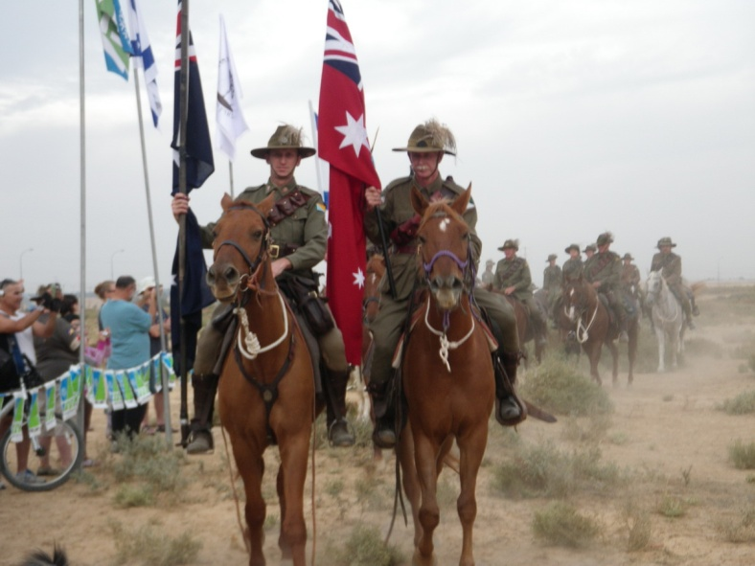
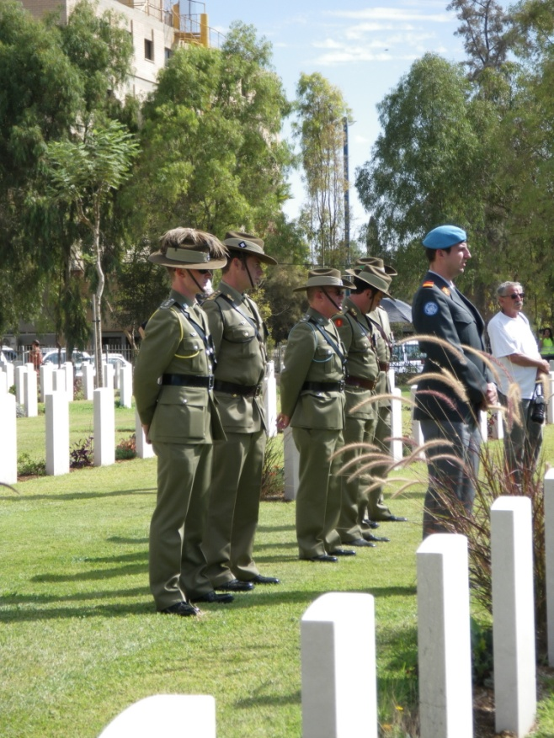
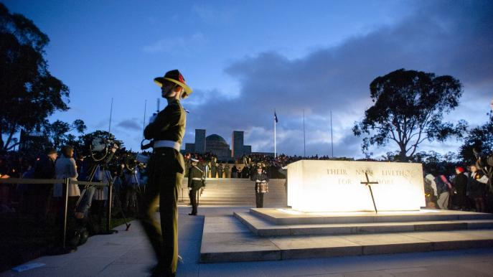
Lest we forget
Notes:
Anzac Day Ode https://au.pinterest.com/tarnyanew/teaching-anzac-day/;
90th Anniversary Parade, Be’er Sheva, Israel – J Curry;
Beersheba Day Service in the cemetery, Be’er Sheva, Israel – J Curry;
ANZAC Day Dawn Service, War Memorial Canberra, http://www.australia.com/en/news/2015/april/anzac-centenary-services-australia.html

