Slide 1
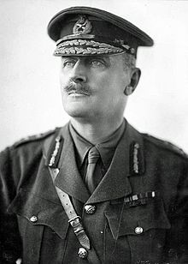
ALLENBY OR AL NEBI?
British Commander
General Sir
Edmund Allenby
Notes:
Sir Edmund Allenby - https://en.wikipedia.org/wiki/Edmund_Allenby

Slide 2
Arab Prophecy
When the Nile flows into Palestine, then shall the prophet from the west drive the Turk from Jerusalem
Notes:
Gilbert, Major Vivian., The Romance of the Last Crusade with Allenby to Jerusalem, Appleton and Company. Pages 177
http://www.primaryclipart.com/search.php?search=jerusalem

Slide 3
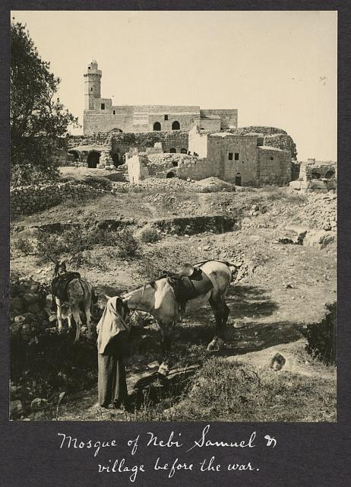
Tomb of the Prophet Samuel
Notes:
Tomb of the Prophet Samuel - http://www.israeldailypicture.com/2011/08/what-you-probably-didnt-know-about-nebi.html

Slide 4
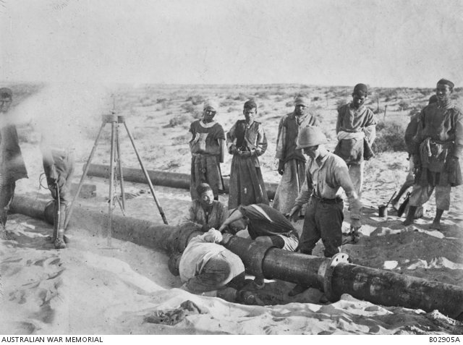
Laying the water pipe
Notes:
Building the pipeline through the Sinai desert. Australian War Memorial - https://www.awm.gov.au/collection/B02905A/

Slide 5
Co-incidence?
Allenby = Al Nebi (Arabic means Prophet of God)
From the West (Britain)
Drove Turks from Jerusalem
As water (pipe) from the Nile began to flow into Palestine

Slide 6
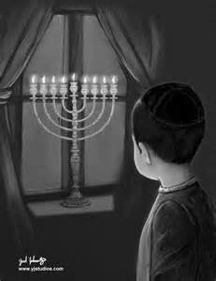
Channukka
Maccabees’ victory over Greeks
– Feast of Dedication
– Festival of Lights
Notes:
http://imgarcade.com/1/chanukah-menorah-in-window/

Slide 7
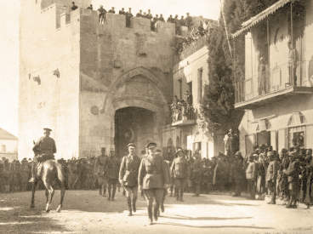
Allenby enters Jerusalem
Notes:
Allenby entering Jerusalem 1917 – British Official Photograph Q12617, https://en.wikipedia.org/wiki/Battle_of_Jerusalem

Slide 8
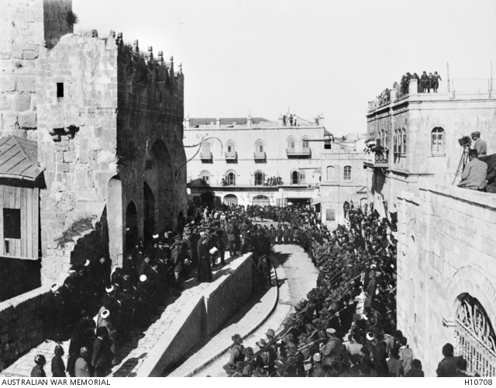
Official handover of Jerusalem
Notes:
The official surrender of Jerusalem December 11, 1917 – Australian War Memorial https://www.awm.gov.au/collection/H10708/

Slide 9
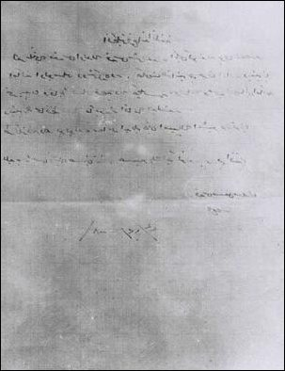
Letter of Surrender
Due to the severity of the siege of the city and the suffering that this peaceful country has endured from your heavy guns; and for fear that these deadly bombs will hit the holy places, we are forced to hand over to you the city through Hussein Bey al-Husseini, the mayor of Jerusalem, hoping that you will protect Jerusalem the way we have protected it for more than five hundred years.
Signed Izzat the Mutasarrif of Jerusalem
Notes:
http://www.firstworldwar.com/source/jerusalemdecree.htm

