Slide 1
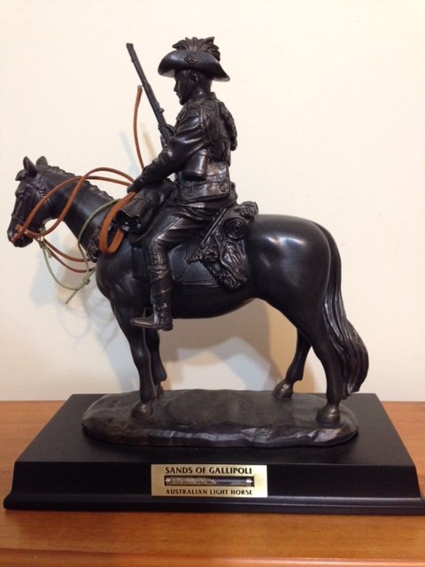
Jordan and the Great Ride
Lesson 4
Notes:
Light Horse commemorative statue - Photo J Curry

Slide 2
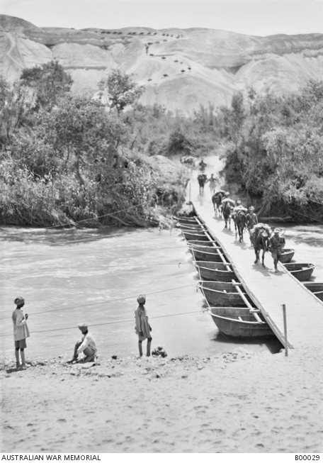
Pontoon bridge over Jordan river
Notes:
Pontoon bridge over Jordan River - https://www.awm.gov.au/collection/B00029

Slide 3
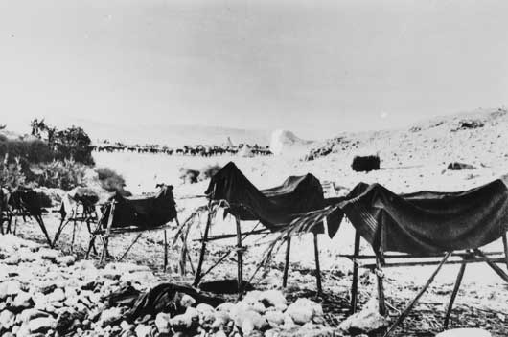
Dummy horses - to confuse the bomber aircraft
Notes:
Dummy horses used to fool German aircraft – Australian War Memorial
https://www.awm.gov.au/collection/B02667/

Slide 4
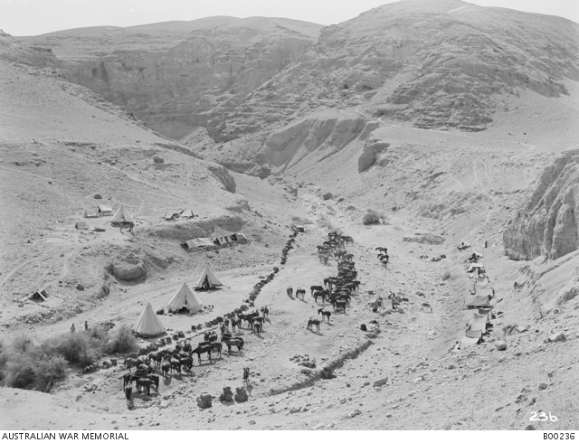
9th Light Horse Jordan Valley
Notes:
9th LH regiment Jordan Valley near Jericho https://www.awm.gov.au/collection/B00236

Slide 5
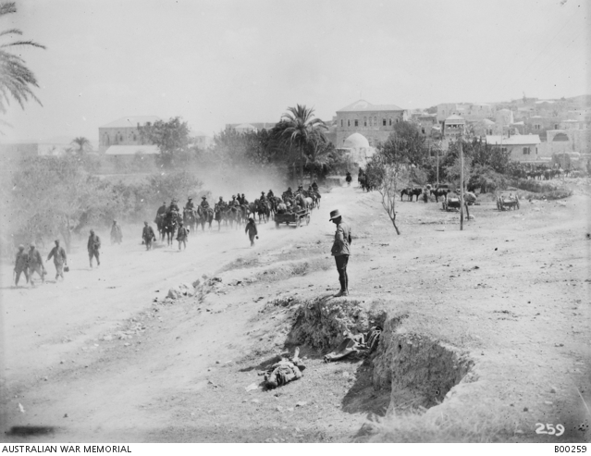
Jenin – taken by 9th and 10th LH regiments
Notes:
9th and 10th LH regiments, Jenin https://www.awm.gov.au/collection/B00259

Slide 6
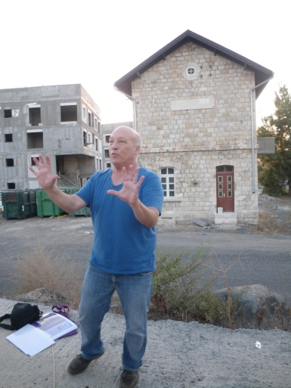
Semakh Station – partially restored - taken by the ANZACs in Sept 1918
Notes:
Ziv Ophir explains about the Semakh railway station (behind) – Jill Curry

Slide 7
ANZAC monument Semakh
Notes:
Australian memorial at Semakh – Jill Curry

Slide 8
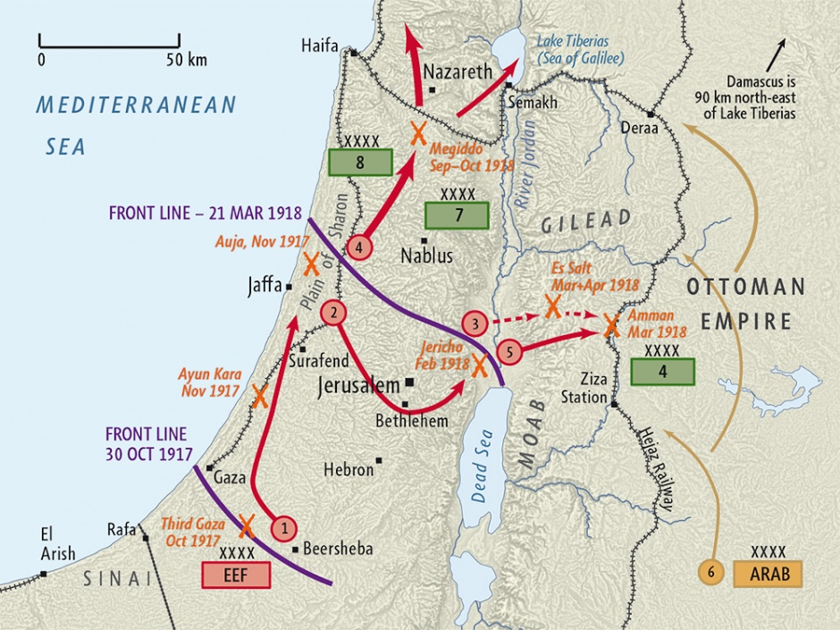
Notes:
Map – Palestine Campaign WW1 - Map produced by Geographx with research assistance from Damien Fenton and Caroline Lord. 'Palestine campaign 1917-18 map', http://www.nzhistory.net.nz/media/photo/palestine-campaign-1917-18-map, (Ministry for Culture and Heritage), updated 14-Aug-2014

Slide 9
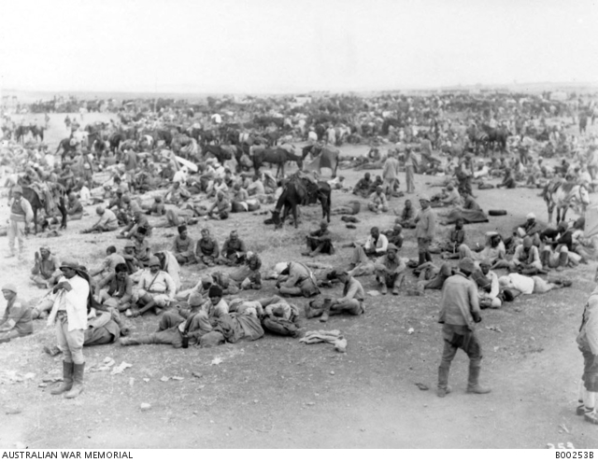
Turkish prisoners of war
Notes:
Turkish Prisoners of War, advance to Damascus - https://www.awm.gov.au/collection/B00253B

Slide 10
Governor’s residence - Damascus
Notes:
Arab troops arriving at the Governor’s residence for the surrender of Damascus – Australian War Memorial https://www.awm.gov.au/collection/J02491/

Slide 11
Damascus hospital
Notes:
Turkish prisoner of war hospital, Kaukab, Damascus https://www.awm.gov.au/collection/B00364

