Slide 1
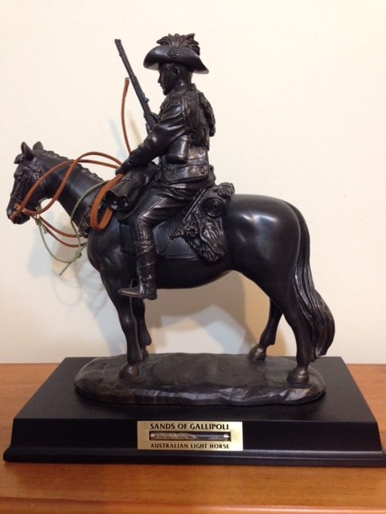
The Sinai Campaign
Lesson 2
Notes:
Light Horse commemorative statue – Photo J Curry

Slide 2
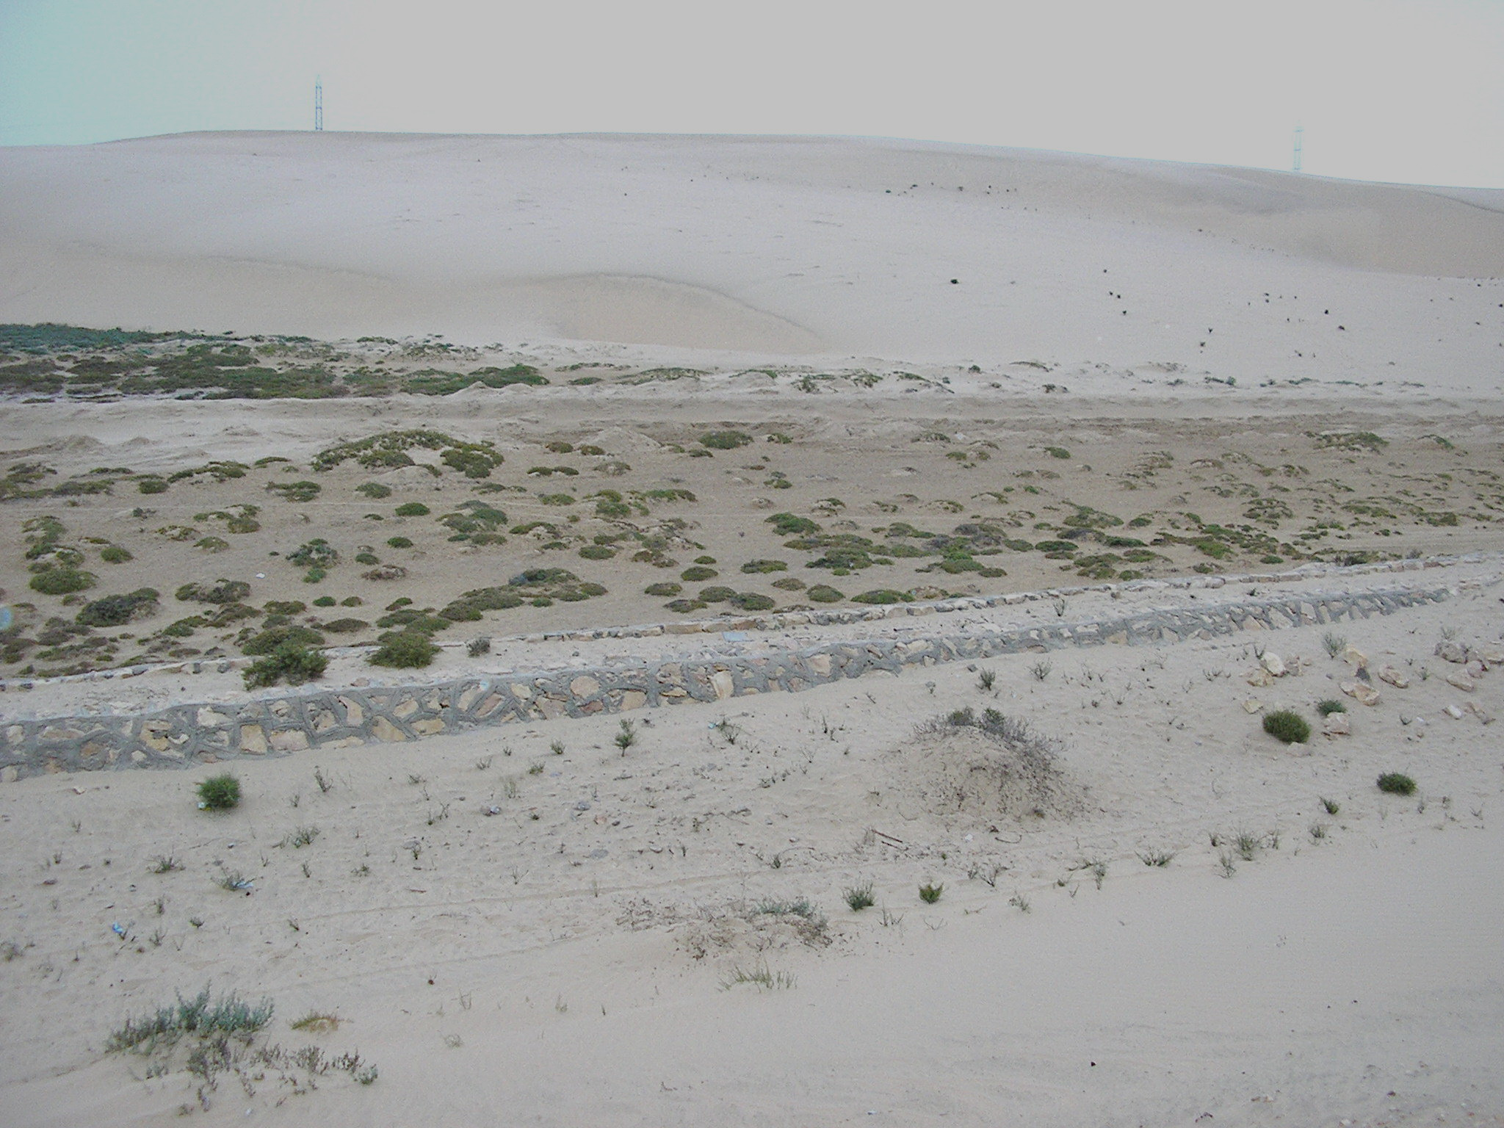
MIDDLE EASTERN CAMPAIGN OF WW1: SINAI
Desert warfare that thwarted the Turkish attack on the Suez canal forcing their retreat
Notes:
Sinai desert – J Curry

Slide 3
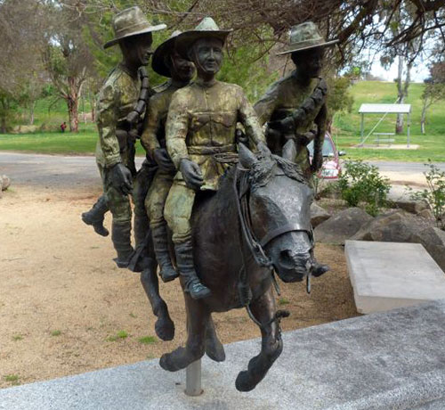
Bill the Bastard Statue
Notes:
Bill the Bastard statue, Murrumburrah, NSW, Australia – http://iwvpa.net/clifford-m/bill-the-.php

Slide 4
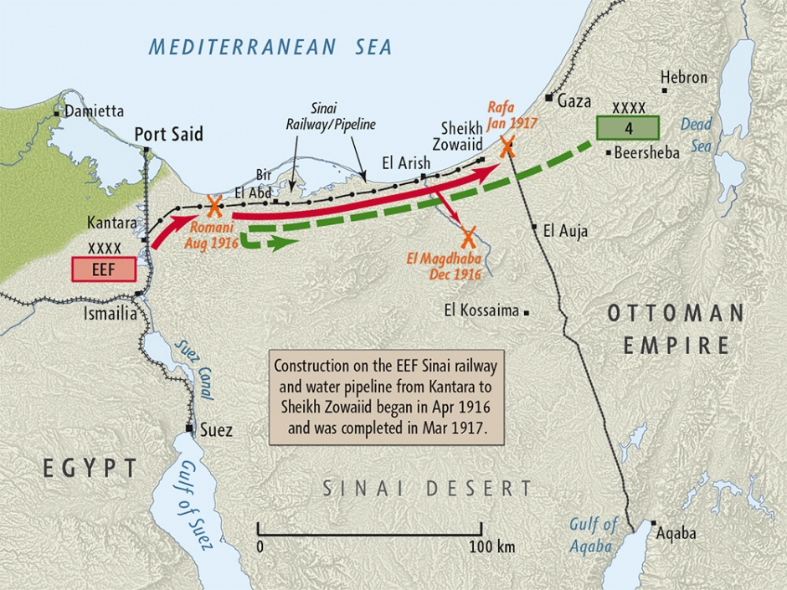
Notes:
Map produced by Geographx with research assistance from Damien Fenton and Caroline Lord. Map of 'Sinai campaign 1916 map', http://www.nzhistory.net.nz/media/photo/sinai-campaign-1916-map, (Ministry for Culture and Heritage), updated 14-Aug-2014

Slide 5
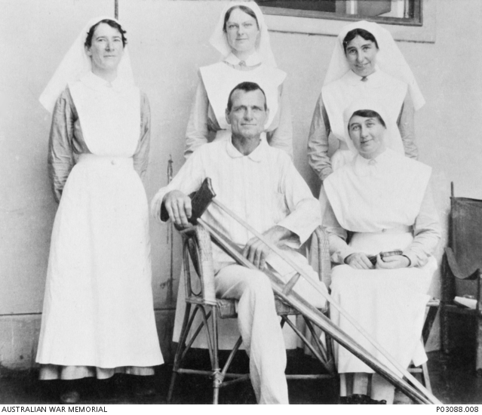
Michael Shanahan in hospital
Notes:
Michael Shanahan in hospital – https://www.awm.gov.au/collection/P03088.008. 2nd Australian Light Horse, Cairo Sept 1916

Slide 6
The Battle of Romani
Lasted 9 days
Scorching temperatures; little water
Fighting in the sand dunes
ANZACs commended
Strong waler horses and tough men
Put on frontline
Changed thinking from defence to attack

Slide 7
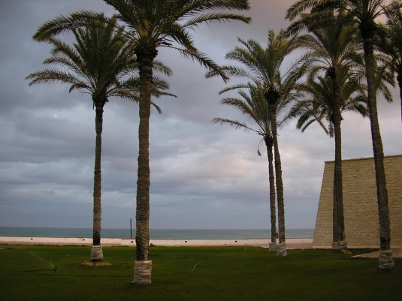
El Arish on the Mediterranean Coast
Notes:
El Arish – Jill Curry

Slide 8
Battle of Maghdaba
Lasted one day
Sleepless nights
Insufficient water
Cemented the ANZAC reputation

Slide 9
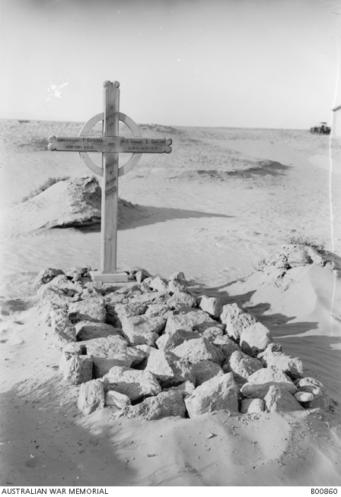
Graves of Australian Troopers Butcher (Aust) and Garland (NZ) both killed at Magdhaba
Notes:
Australian War Memorial https://www.awm.gov.au/collection/B00860 .

Slide 10
Rafa and Gaza
January 1917 – Battle of Rafa – Successful
March 1917 – First battle of Gaza – Failed
April 1917 – Second Battle of Gaza – Failed
New strategy needed

Slide 11
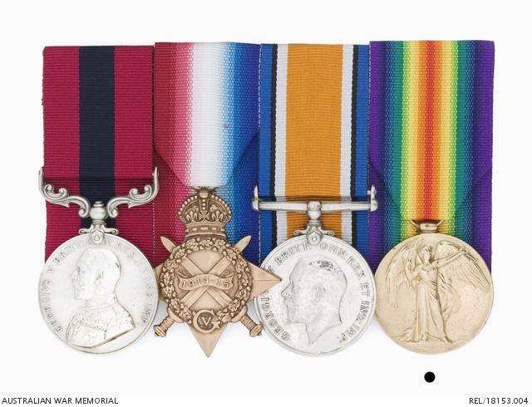
ANZAC VALUES
Courage
Sacrifice
Endurance
Mateship
Notes:
Distinguished Conduct Medals: Trooper C H Livingstone, 6 Light Horse Regiment, AIF https://www.awm.gov.au/collection/REL/18153.002

