Slide 1
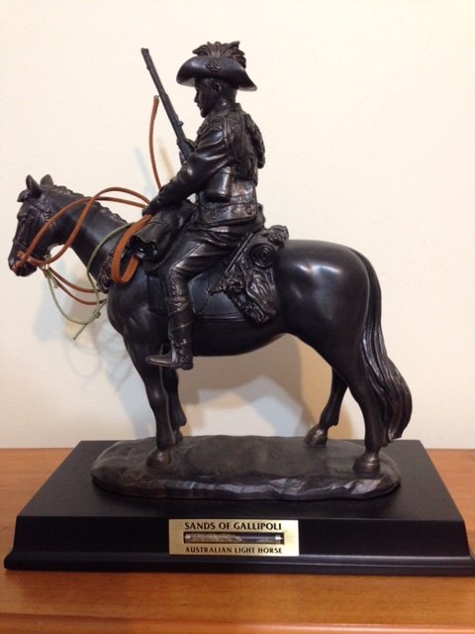
ANZACs and Walers
Lesson 1
Notes:
Lighthorse commemorative statue - Picture J Curry

Slide 2
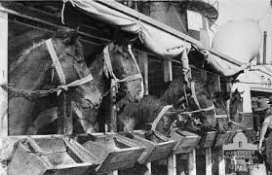
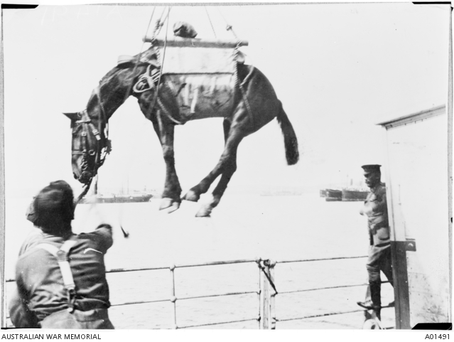
Horses and men travelled by ship
Notes:
Horses aboard transport ship http://baroquehorse.com.au/100-years-for-the-anzac-horses-in-war/
Loading horse onto ship https://www.awm.gov.au/collection/A01491

Slide 3
Use of Horses in War
Move the men
Haul guns
Carry mail
Carry the wounded down the steep slopes
Camels & donkeys were also used

Slide 4
What the Walers endured
130 kg of luggage
50 degrees in the desert
No shade
Soft sand
Hard rocky ground
Slippery mud
Sometimes 3 days with no water

Slide 5
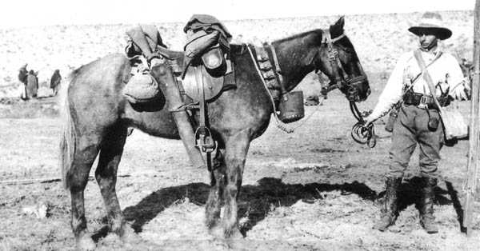
Taffy loaded up
Notes:
Taffy & Cpl Edwards – Light Horse WW1 http://www.lighthorseart.com.au/Taffy-Waits/

Slide 6
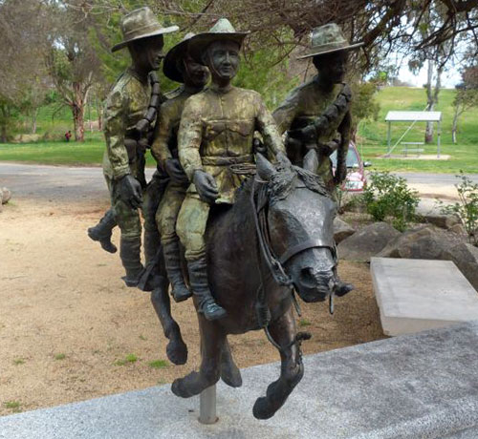
Bill the Bastard Statue
Notes:
Bill the Bastard statue, Murrumburrah, NSW, Australia – http://iwvpa.net/clifford-m/bill-the-.php

Slide 7
Best Mates
– painting by Light Horse artist
Jennifer Marshall
Notes:
Best Mates – Jennifer Marshall http://www.lighthorseart.com.au/Best-Mates.html

Slide 8
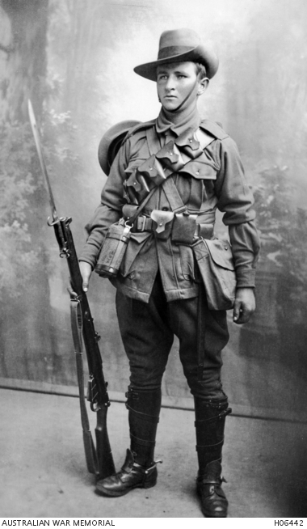
400,000 volunteered
60,000 died
156,000 wounded
Left family, friends, homes and jobs
Notes:
Trooper Stephen Arbuthnot – 8th Light Horse, Killed at Gallipoli https://www.awm.gov.au/collection/H06442/

Slide 9
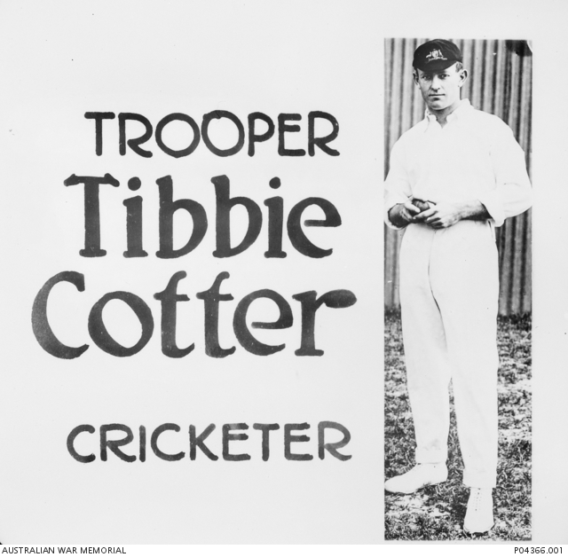
32,000 served in the Middle East
1,394 died including Tibbie Cotter
Notes:
Tibbie Cotter WW1 recruitment poster - https://www.awm.gov.au/collection/P04366.001

Slide 10
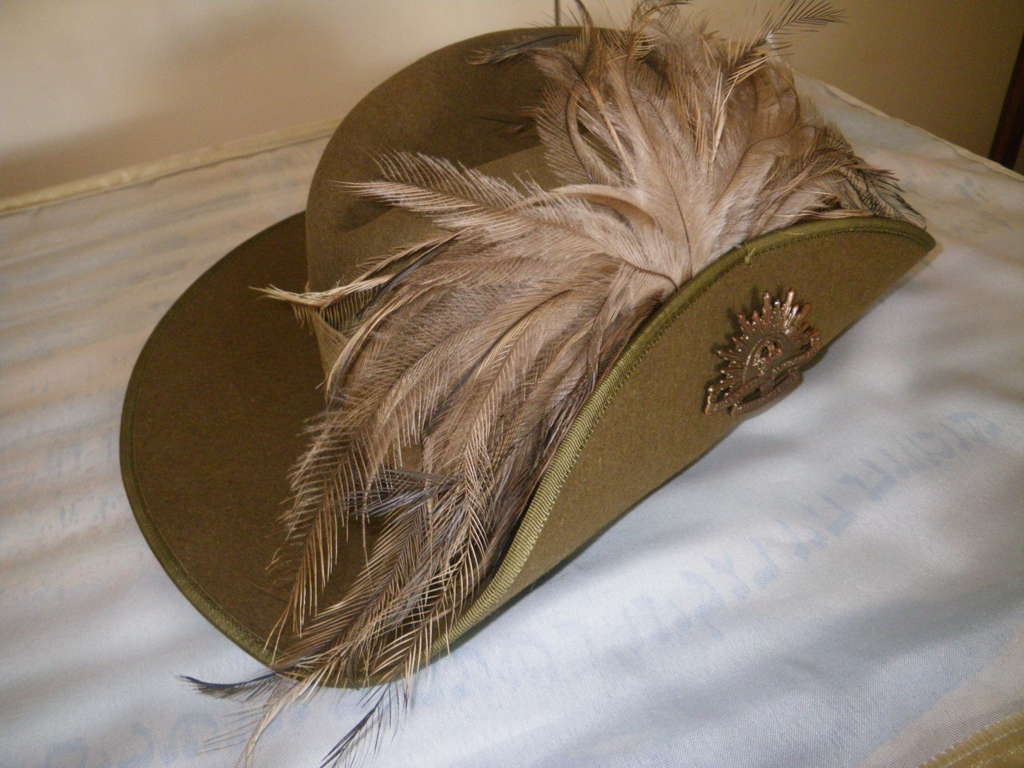
Slouch Hat with Emu Feathers
Notes:
Slouch Hat with Emu Feathers – Jill Curry

Slide 11
Only one Horse returned
136,000 horses went to war
Only one returned
They did not volunteer

Slide 12
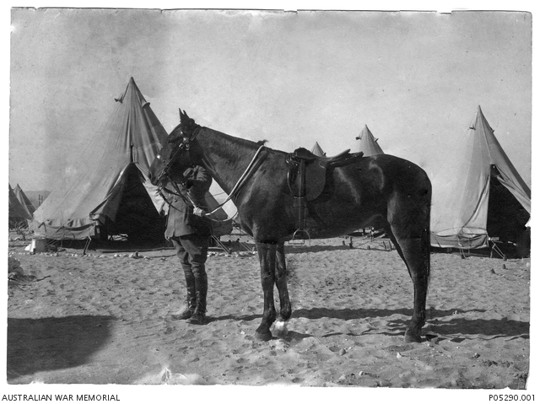
Sandy – one returned
Notes:
Sandy – Major General Sir William Throsby Bridges, KCB, CMG, Commander of the Australian Imperial Force (AIF) and of the 1st Australian Division in 1914-1915,
https://www.awm.gov.au/collection/P05290.001

