Slide 1
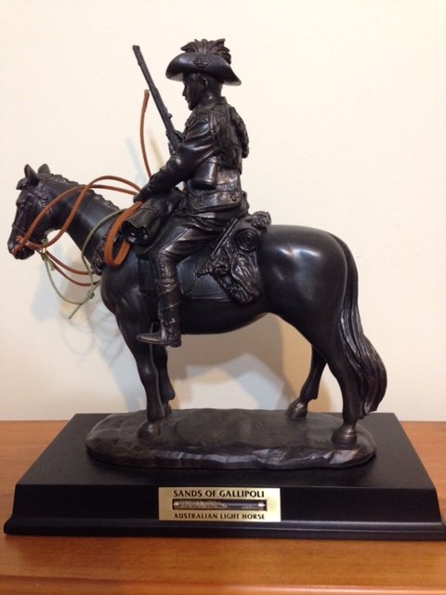
Jordan, Syria and the Great Ride
Notes:
Light Horse commemorative statue - Photo J Curry

Slide 2
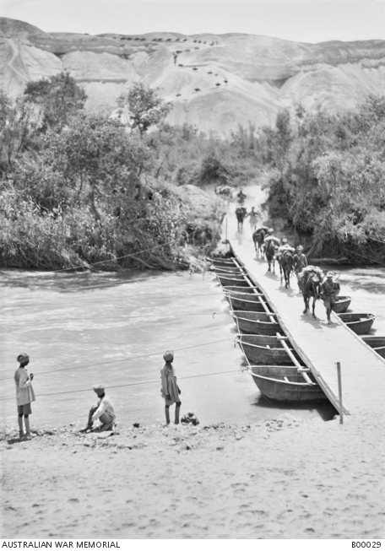
Pontoon bridge over Jordan river
Notes:
Pontoon bridge over Jordan River - https://www.awm.gov.au/collection/B00029

Slide 3
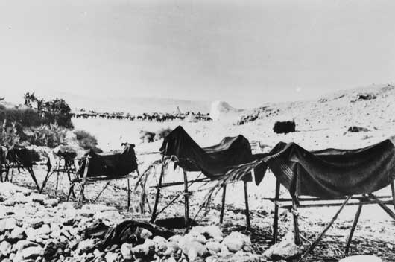
Dummy horses - to confuse the bomber aircraft
Notes:
Dummy horses used to fool German aircraft – Australian War Memorial
https://www.awm.gov.au/collection/B02667/

Slide 4
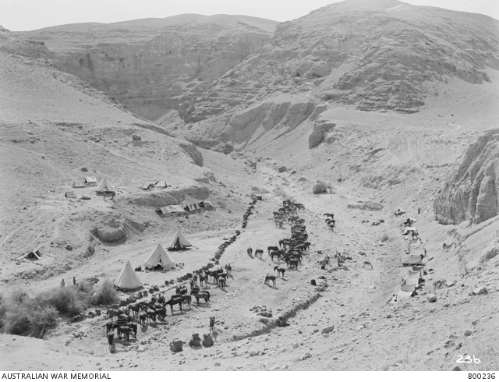
9th Light Horse Jordan Valley
Notes:
9th LH regiment Jordan Valley near Jericho https://www.awm.gov.au/collection/B00236

Slide 5
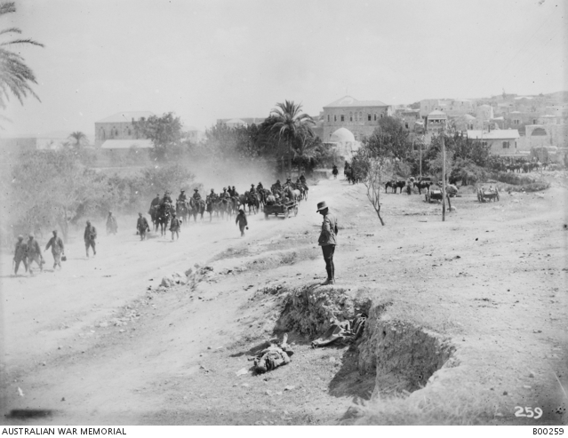
Jenin – taken by 9th and 10th Light Horse regiments
Notes:
9th and 10th LH regiments, Jenin https://www.awm.gov.au/collection/B00259

Slide 6
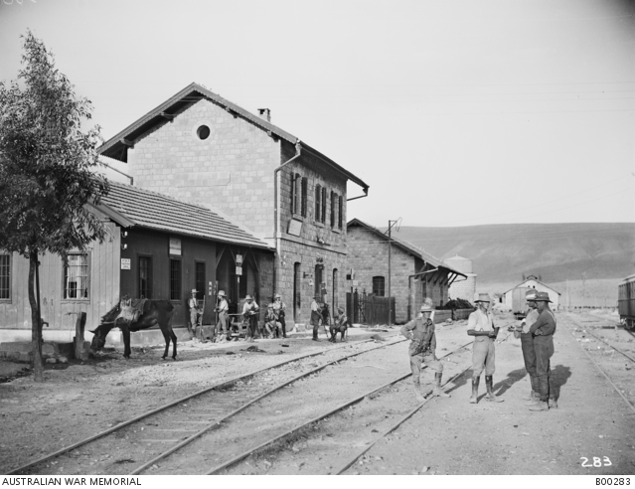
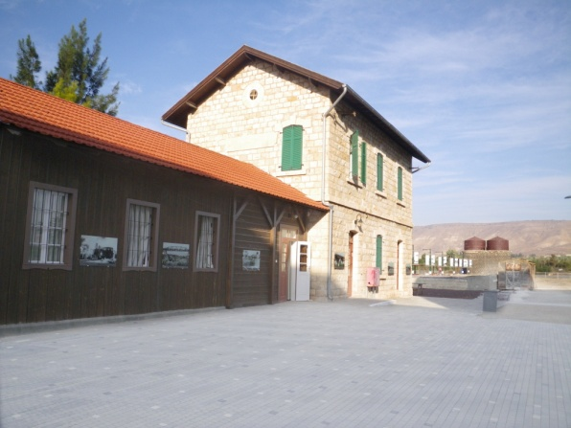
Semakh Station – in 1918 and now restored
Notes:
Semakh railway station Australian War Memorial B00283 and now – Jill Curry

Slide 7
ANZAC monument Semakh
Notes:
Australian memorial at Semakh – Jill Curry

Slide 8
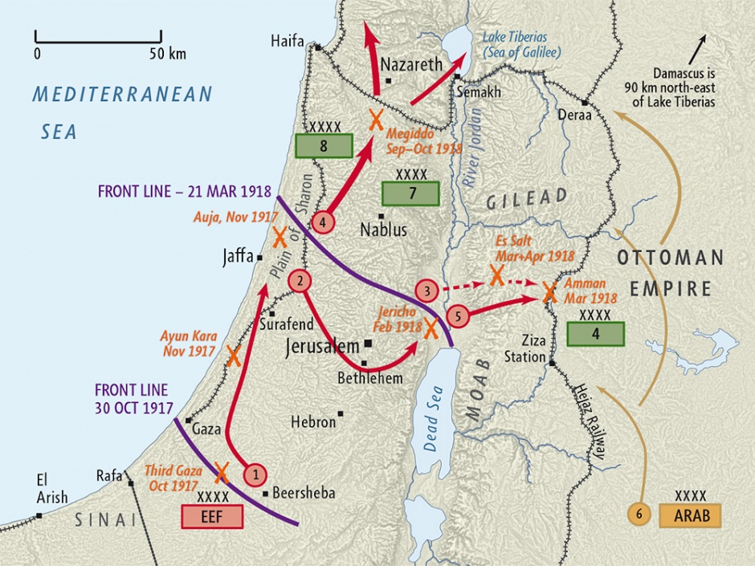
Notes:
Map – Palestine Campaign WW1 - Map produced by Geographx with research assistance from Damien Fenton and Caroline Lord. 'Palestine campaign 1917-18 map', http://www.nzhistory.net.nz/media/photo/palestine-campaign-1917-18-map, (Ministry for Culture and Heritage), updated 14-Aug-2014

Slide 9
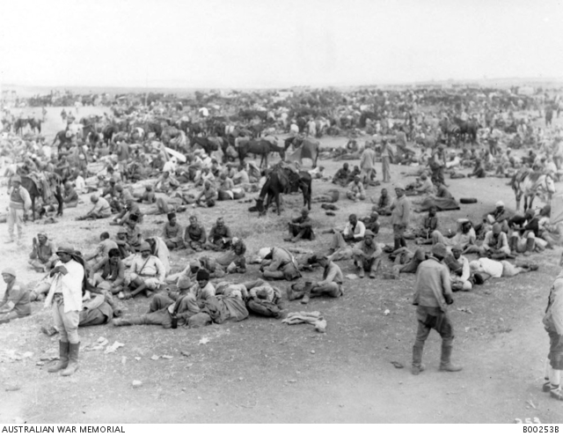
Turkish prisoners of war
Notes:
Turkish Prisoners of War, advance to Damascus - https://www.awm.gov.au/collection/B00253B

Slide 10
Governor’s residence - Damascus
Notes:
Arab troops arriving at the Governor’s residence for the surrender of Damascus – Australian War Memorial https://www.awm.gov.au/collection/J02491/

Slide 11
Damascus hospital
Notes:
Turkish prisoner of war hospital, Kaukab, Damascus https://www.awm.gov.au/collection/B00364

Slide 12
Accomplishments
Defeated 3 Turkish armies – that had decimated the ANZACs in Gallipoli
Captured 75,000 prisoners and 360 guns
Ended the Ottoman Empire & the war in the Middle East
Liberated ¾ of Palestine (today Jordan and northern Israel) and Syria (today Lebanon and Syria) & re-wrote the maps of the Middle East

Slide 13
Gen Sir Harry Chauvel
General Sir Harry Chauvel commanded a corps of 34,000 mounted troops
They travelled 560 kilometres from Jaffa to Aleppo in 6 weeks on horseback
Attacked across a front of 160 kilometres
All accomplished while plagues of sickness were hitting the troops
Created the ANZAC Light Horse legend

Slide 14
General Sir Harry Chauvel
Notes:
General Sir Harry Chauvel in 1923 https://www.awm.gov.au/collection/J00503/

