Slide 1
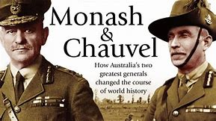
Two great Australian Generals
Monash and Chauvel

Slide 2
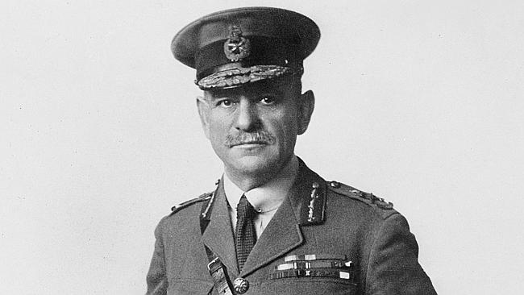
General Sir John Monash
Commander of the Australian Corps AIF
on the Western Front
Notes:
General Sir John Monash- Photo by Swaine. https://www.awm.gov.au/collection/AO2697/

Slide 3
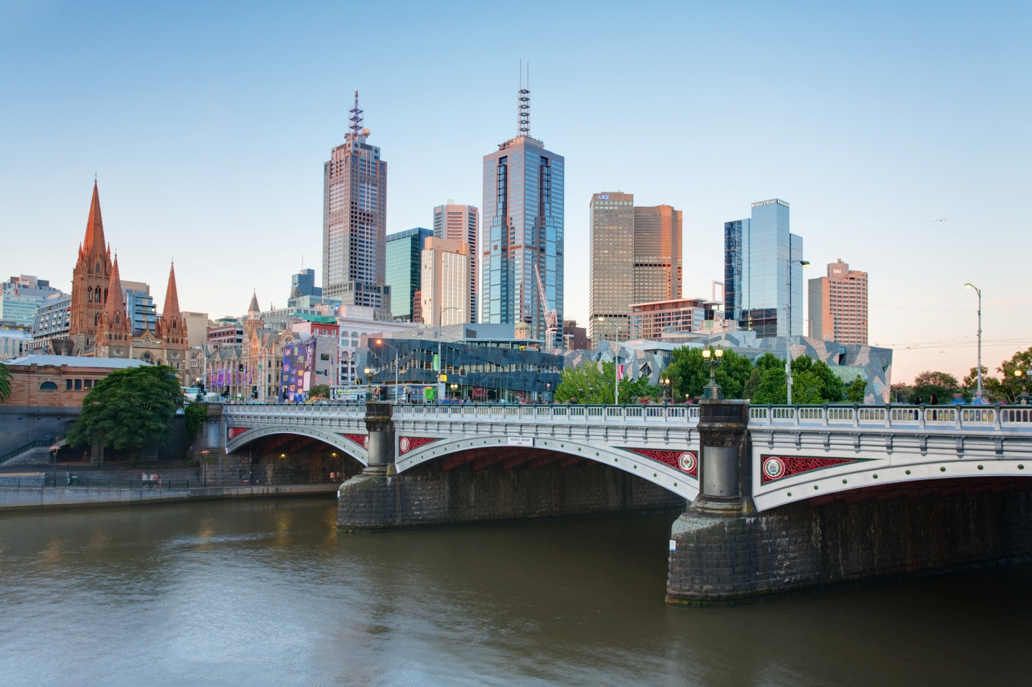
Princes Bridge, Melbourne
Notes:
https://en.wikipedia.org/wiki/File:Melbourne_Skyline_and_Princes_Bridge_-_Dec_2008.jpg

Slide 4
Monash in 1915
Notes:
https://www.awm.gov.au/collection/C525 Photo A01241

Slide 5
Quinn’s Post - Gallipoli
Notes:
https://www.awm.gov.au/collection/C57440 Photo G01005 by Bean

Slide 6
Broodseinde Ridge near Ypres
Notes:
https://www.awm.gov.au/collection/C954989 Photo E01149

Slide 7
Monash 1918
Notes:
https://www.awm.gov.au/collection/C600 Photo A02697 by Swaine

Slide 8
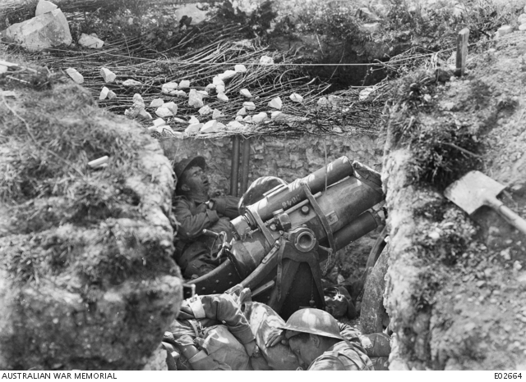
Hamel July 4 1918
Notes:
https://www.awm.gov.au/collection/C962382?image=2 Photo E02637
https://www.awm.gov.au/collection/C43260 Photo E02664 Asleep in the trenches

Slide 9
Mont St Quentin
Notes:
https://www.awm.gov.au/collection/C55032 E03210

Slide 10
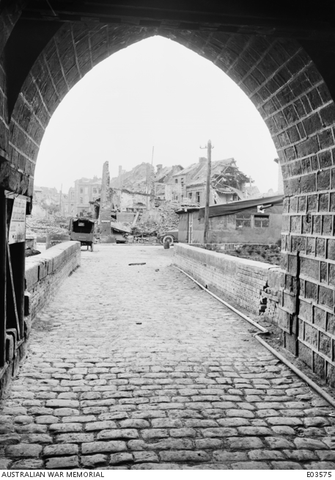
Peronne
Notes:
https://www.awm.gov.au/collection/C970929 Photo E05314
https://www.awm.gov.au/collection/C369545 Photo E03575

Slide 11
Hindenburg line
Notes:
http://www.wikiwand.com/es/Línea_Hindenburg

Slide 12
hOme at last
Notes:
https://www.awm.gov.au/collection/C42601 Photo H16140

Slide 13
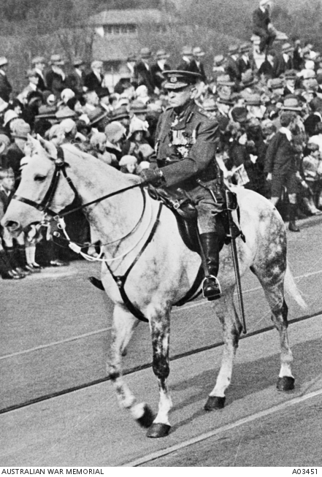
Monash leads Anzac Day march 1931
Notes:
Monash leading Anzac Day March 1931 https://www.awm.gov.au/collection/C1007311 Photo A03451
https://www.awm.gov.au/collection/C1004828 Photo A02691 By Ellliott and Fry

Slide 14
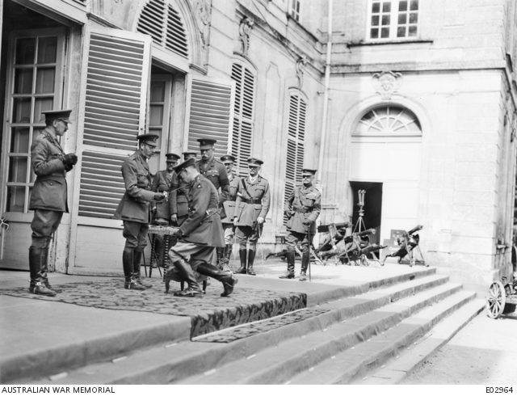
Notes:
https://www.awm.gov.au/collection/C397948 Photo E02964

Slide 15
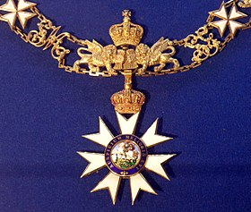
Knight Grand Cross of the Order of st Michael and St George
Notes:
https://commons.wikimedia.org/wiki/File:Order_of_Saint_Michael_and_Saint_George_grand_cross_collar_badge_(United_Kingdom_1870-1900)_-_Tallinn_Museum_of_Orders.jpg

Slide 16
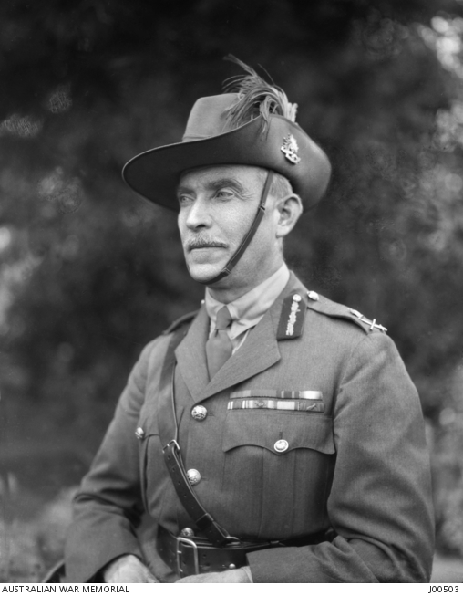
General Sir Harry Chauvel
Commander of the Desert Mounted Corps
Notes:
Harry Chauvel in 1923 https://www.awm.gov.au/collection/J00503/

Slide 17
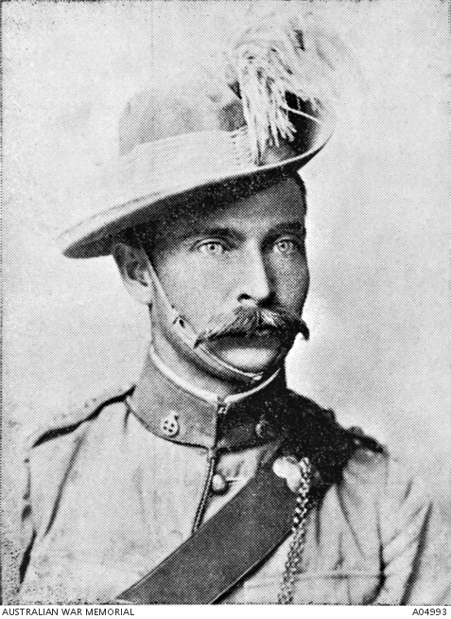
Chauvel as a young man
Notes:
Harry Chauvel as a young man in the Queensland Mounted Infantry https://www.awm.gov.au/collection/A04993/

Slide 18
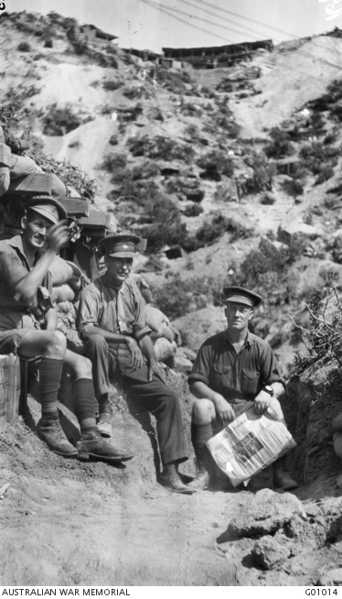
GAllipoli
Chauvel led the 1st Light Horse Brigade in Gallipoli
Notes:
Australian War Memorial https://www.awm.gov.au/collection/G01014/ Photo by Charles Bean. Gallipoli Peninsula, Turkey. 1915. General Chauvel with Major E.M. Williams, Brigade Major of the 1st Australian Light Horse (left) and Staff Captain Walter Percy Farr (right).

Slide 19
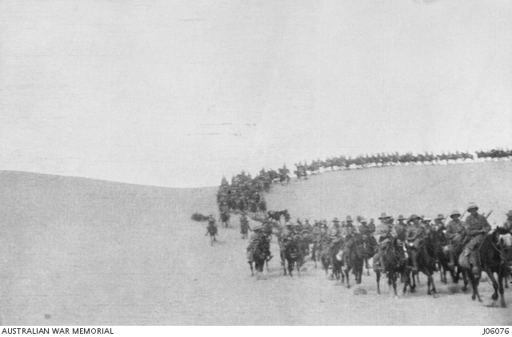
The Allied forces lost 202 men, mostly ANZACS
The Turkish toll was 1,250 killed, almost 4,000 injured and another 4,000 captured
Notes:
https://www.awm.gov.au/collection/ Photo J06076

Slide 20
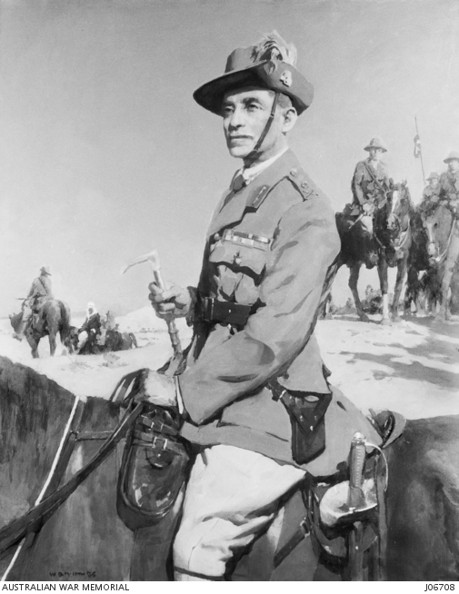
In the Sinai dEsert
Notes:
Australian War Memorial https://www.awm.gov.au/collection/J06708/ Sir Harry Chauvel. Portrait by McInnis.

Slide 21
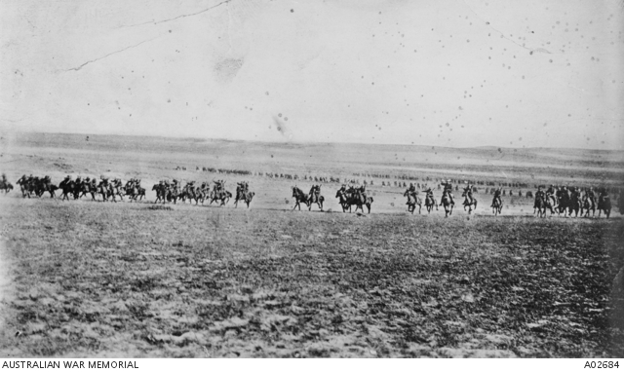
Charge of Beersheba
Notes:
Disputed picture of the charge at Beersheba (or re-enactment) – Australian War memorial
https://www.awm.gov.au/collection/A02684/ It was probably taken when two regiments of the 4th Brigade, Australian Light Horse, re-enacted the charge for the official photographer Frank Hurley, at Belah on 7 February 1918.

Slide 22
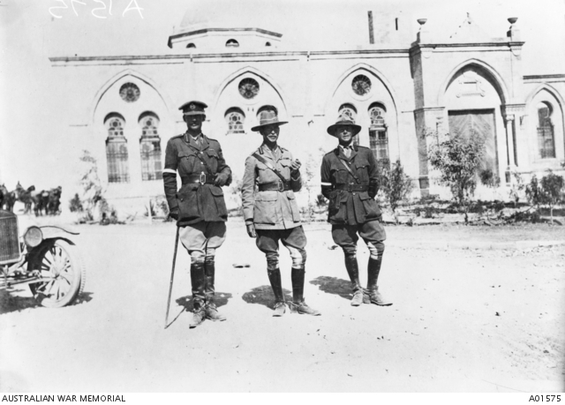
The day after capturing beersheba
Notes:
Australian War Memorial https://www.awm.gov.au/collection/A01575/ General Sir H G Chauvel GOC, Desert Mounted Corps (centre) with Brigadier General R G H Howard-Vyse CMG DSO, his Brigadier General, General Staff (BGGS) (left) and Captain W G Lyons MC (right), one of his Aide de Camps (ADC). Photo taken the day after the capture of Beersheba.

Slide 23
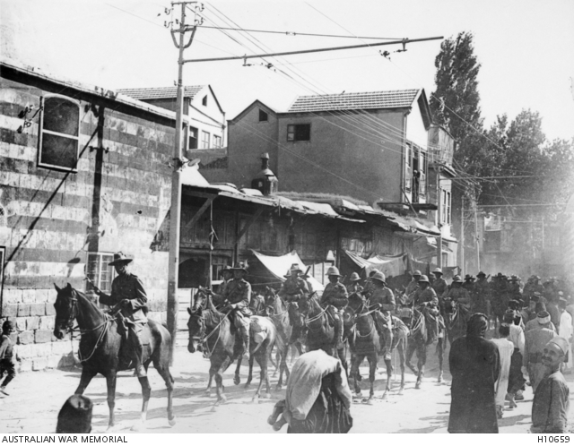
damascus
Notes:
Chauvel leading the troops through Damascus https://www.awm.gov.au/collection/H10659/

Slide 24
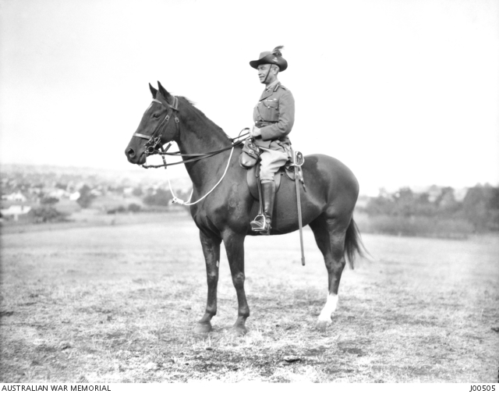
Inspector general of the army
Notes:
Chauvel on horse Maribyrnong 1923. https://www.awm.gov.au/collection/J00505/

Slide 25
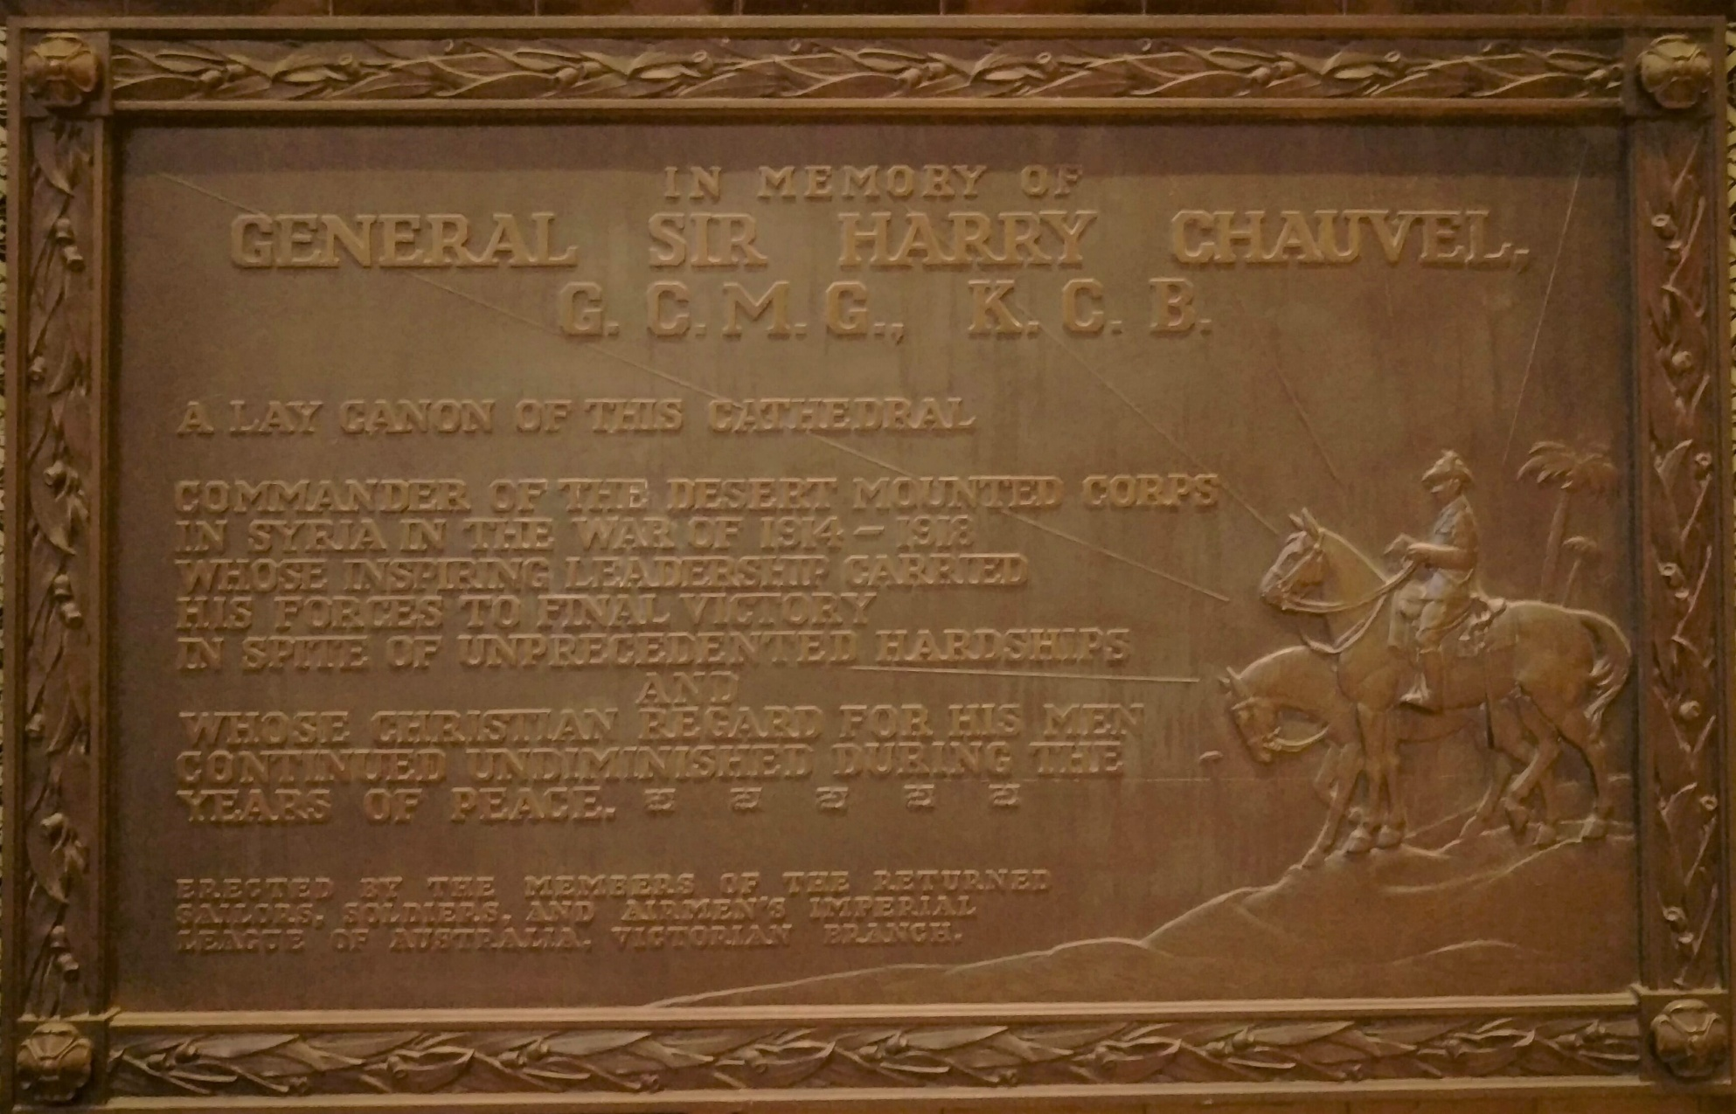
Memorial plaque to Chauvel
St Paul’s Cathedral Melbourne
Notes:
Memorial plaque St Paul’s Cathedral Melbourne – P Kentley

Slide 26
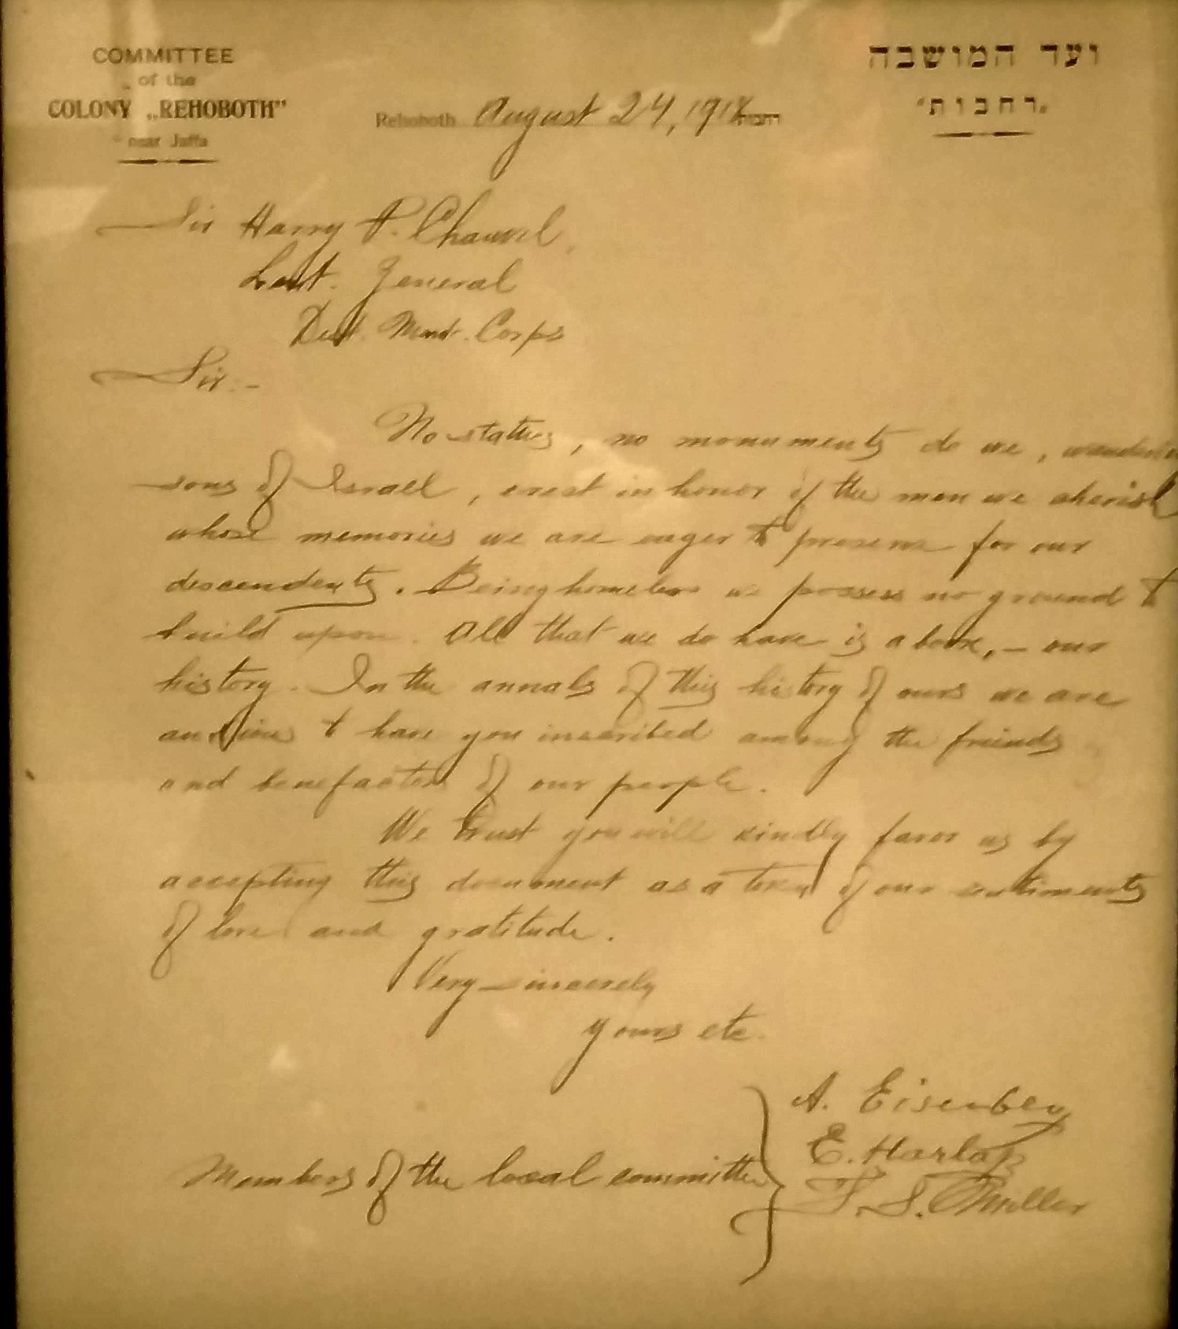
Letter of appreciation from the Rehovot Community to Chauvel
Notes:
Letter from the collection of Richard Chauvel – displayed at the Shrine of Remembrance in Melbourne 2018 – P. Kentley

Slide 27
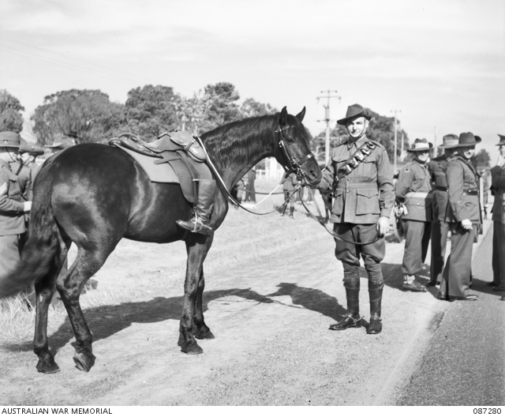
Chauvel’s funeral
Boots in reverse mean fallen soldier not returning
Notes:
Australian War Memorial https://www.awm.gov.au/collection/087280/ Photo John Lee.
Sir Harry Chauvel's horse with the rider's boots set in reverse.

