Slide 1
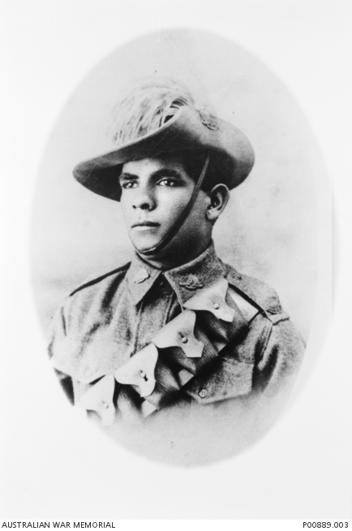
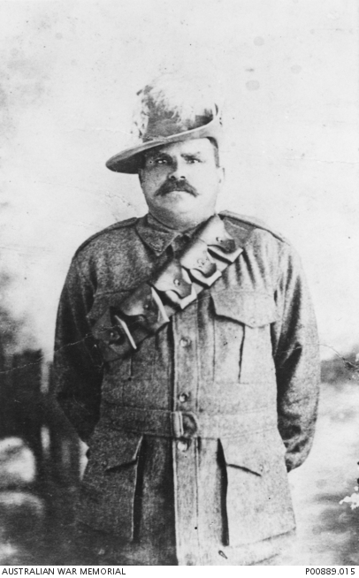
Aborigines in the Light Horse
Notes:
Horace Thomas Dalton, 11th Light Horse Regiment https://www.awm.gov.au/collection/P00889.003;
Frank Fisher, 11th Light Horse regiment was a well-known Rugby player and Cathy Freeman’s great-grandfather. https://www.awm.gov.au/collection/P00889.015

Slide 2
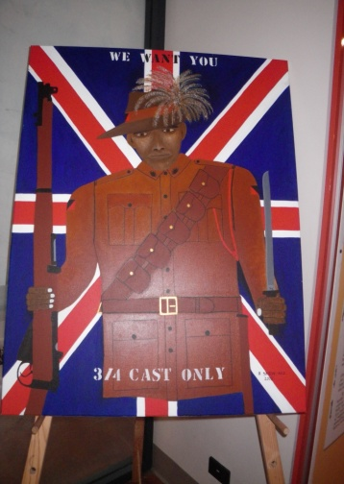
Painting by R Synon – Townsville Cultural Centre
Notes:
Painting by indigenous artist R. Syron, Townsville Cultural Centre – Jill Curry.

Slide 3
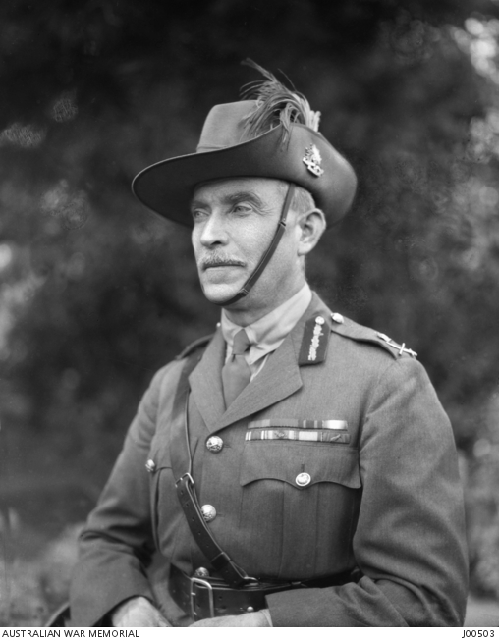
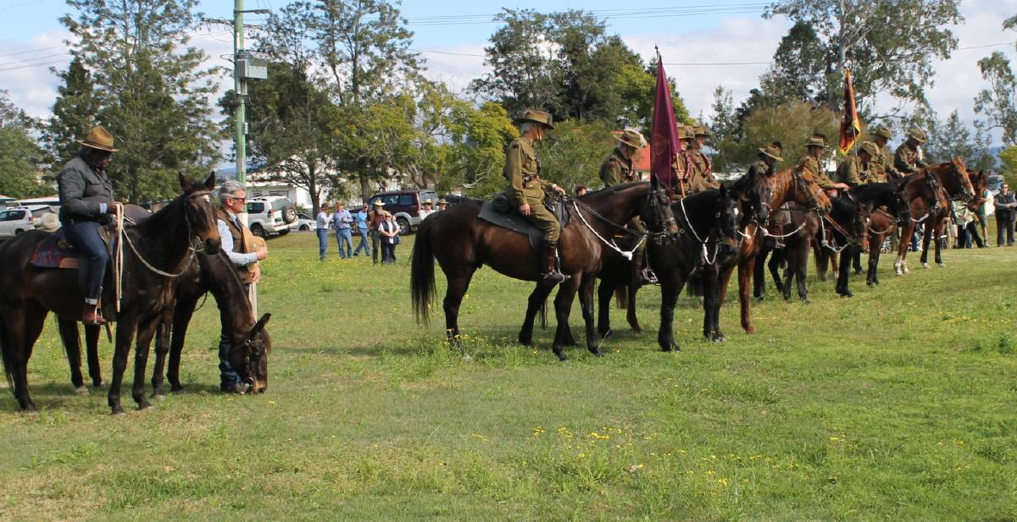
General Sir Harry Chauvel
Chauvel commemoration
Tabulam 2017
Notes:
Australian War Memorial Photo J00503;
https://www.theland.com.au/story/4800934/celebrating-the-light-horse-photos-video/

Slide 4
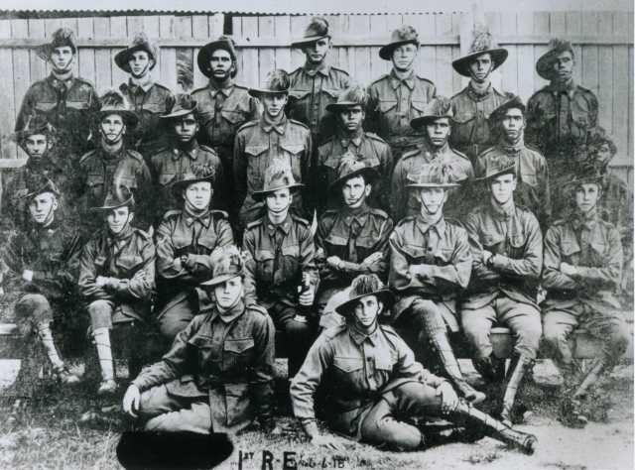
The ‘Queensland Black Watch’
Notes:
Ist Reinforcements Egypt. June 1918. Too Dark for the Light Horse Collection. Courtesy David Huggonson. Website: https://indigenoushistories.com/2015/04/15/charlie-alley-light-horseman-the-service-tradition-of-the-alley-family/

Slide 5
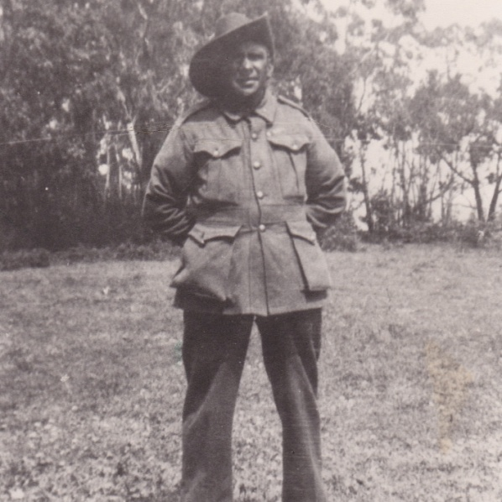
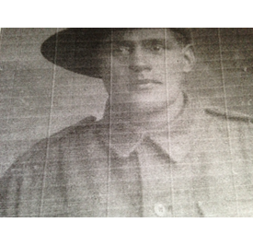
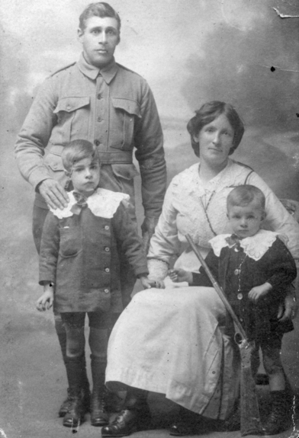
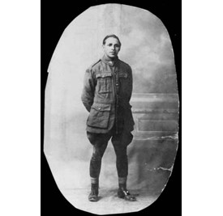
Lovett brothers
Herbert
Edward
Alfred
Frederick
Leonard
Notes:
https://www.vic.gov.au/aboriginalvictoria/community-engagement/leadership-programs/aboriginal-honour-roll/2013-victorian-aboriginal-honour-roll/the-lovett-brothers.html
https://discoveringanzacs.naa.gov.au/browse/person/341562

Slide 6
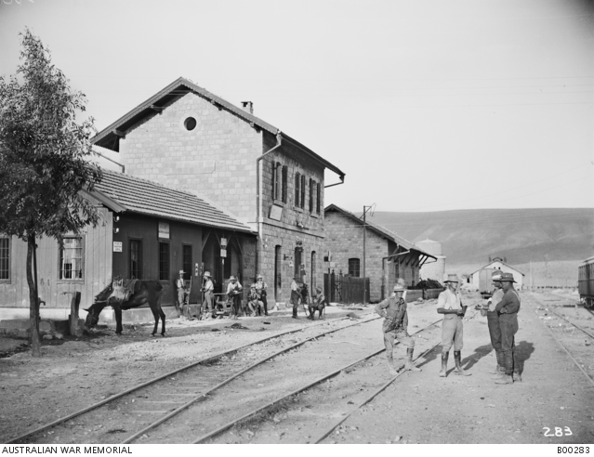
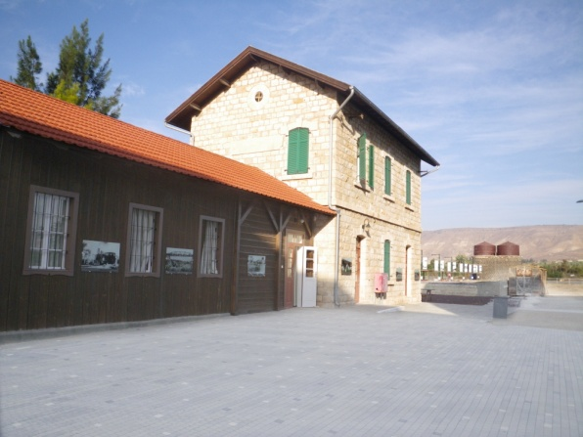
Semakh Station – in 1918 and now restored
Notes:
Semakh railway station Australian War Memorial Photo B00283 and now – Jill Curry

Slide 7
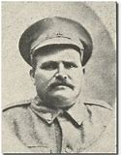
Frank Fisher – 11th ALH
Notes:
https://www.awm.gov.au/collection/P00889.015
http://blogs.slq.qld.gov.au/ww1/2017/05/26/queensland-indigenous-soldiers/

Slide 8
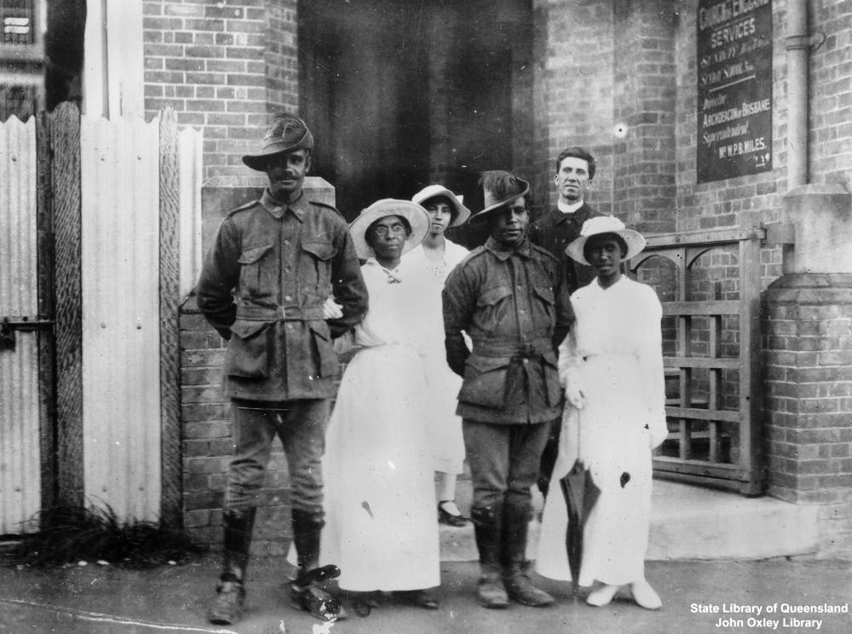
James Lingwoodock – 11th ALH
Wedding of Lingwoodock and Geary
Notes:
https://www.awm.gov.au/collection/P00889.007/
https://rslvirtualwarmemorial.org.au/explore/people/49902

Slide 9
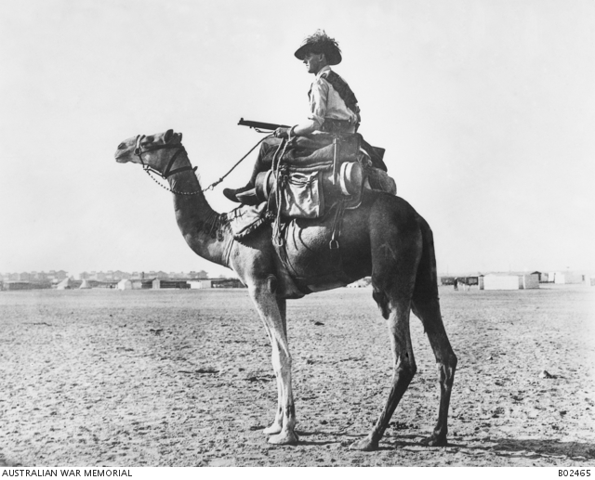
Imperial Camel Corps
Notes:
Australian War Memorial Photos B02465 and J01097

Slide 10
Daniel Cooper
Shepparton
Killed in Action
20th September
1917, Belgium
Notes:
Photo Abe Schwarz

