Slide 1
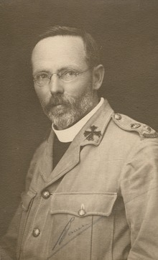
The Architect of Anzac Day
Canon David Garland - “nothing is too good for our soldier boys”
Notes:
http://blogs.slq.qld.gov.au/ww1/tag/anzac-day/ - John Oxley Library, State Library of Queensland Image: 28069-0001-0003

Slide 2
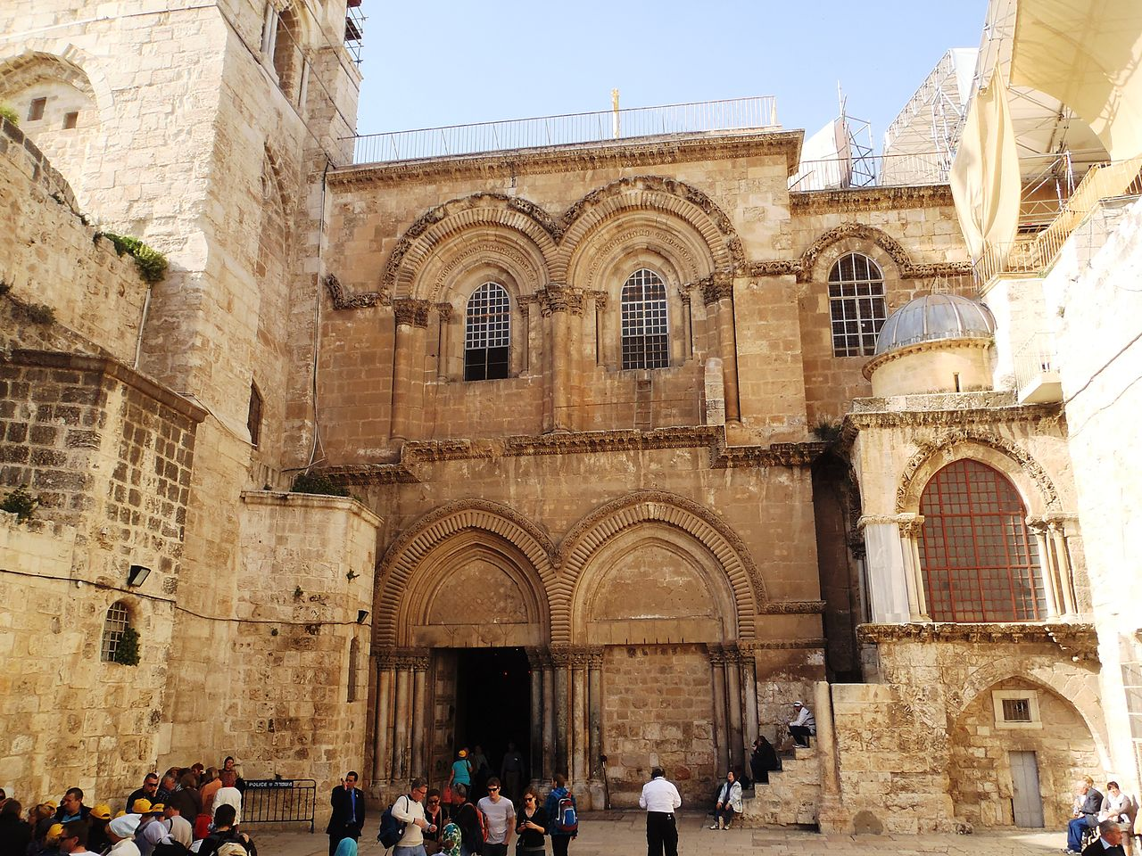
Church of the Holy Sepulchre
Notes:
https://commons.wikimedia.org/wiki/File:Church_of_the_Holy_Sepulchre,_Jerusalem.JPG

Slide 3
“Our troops here have made a magnificent contribution. It is not too much to say that the collapse of the enemy throughout the world was at least hastened by the cavalry feat which, sweeping Palestine and Syria in a manner unknown in history, ensured Turkey’s break-away from Germany.
Notes:
http://www.garlandmemorial.com/category/the-journey/at-the-front/ – from page 9, “The Brisbane Courier” newspaper of 30 April 1919.

Slide 4
I fear that the hardships endured and the magnificent fighting done by the Australian Light Horse have not been fully realised in Australia, and yet it may safely be said that nowhere had our Australian soldiers harder conditions or more strenuous fighting or less relaxation and comforts, which facts make our work all the more necessary.”
Notes:
http://www.garlandmemorial.com/category/the-journey/at-the-front/ – from page 9, “The Brisbane Courier” newspaper of 30 April 1919.

Slide 5
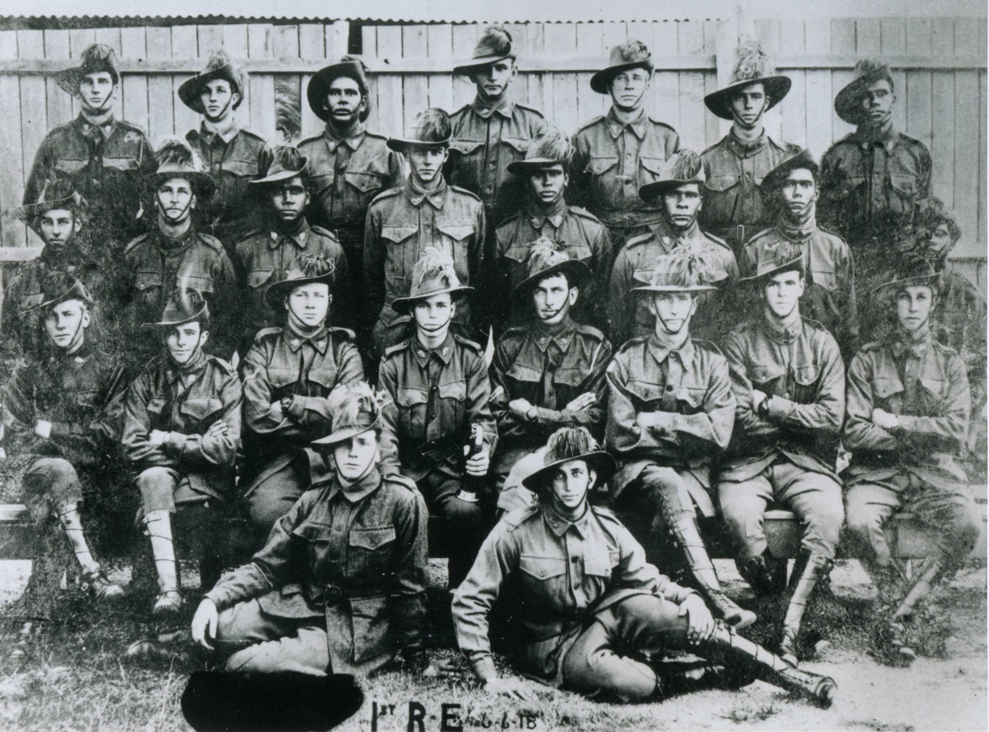
Indigenous light horsemen
Notes:
https://indigenoushistories.com/2015/04/15/charlie-alley-light-horseman-the-service-tradition-of-the-alley-family/

Slide 6
Designed the anzac service
Garland creating the format for a service
He carefully selected hymns, odes and poems that would be acceptable to the wide variety of parties
Included the minute’s silence.

Slide 7
Anzac Day ode
Notes:
http://sps-superstars.wikispaces.com/anzac+day

Slide 8
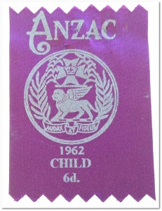
Ribbons sold to support soldiers
Funded war memorials
Paid for upkeep of graves
Supported veterans
Notes:
http://blogs.slq.qld.gov.au/ww1/tag/anzac-day/ Memorial Ribbons, Anzac Day
John Oxley Library, State Library of Queensland

Slide 9
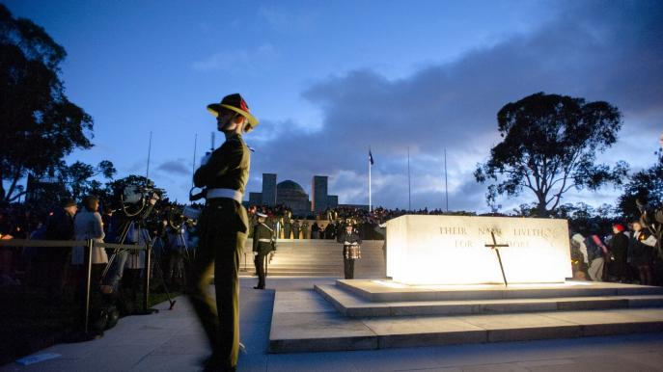
He lobbied for ANZAC Day to become a public holiday in all states which he achieved by 1930.
Notes:
http://www.australia.com/en-sg/news/2015/april/anzac-centenary-services-australia.html

Slide 10
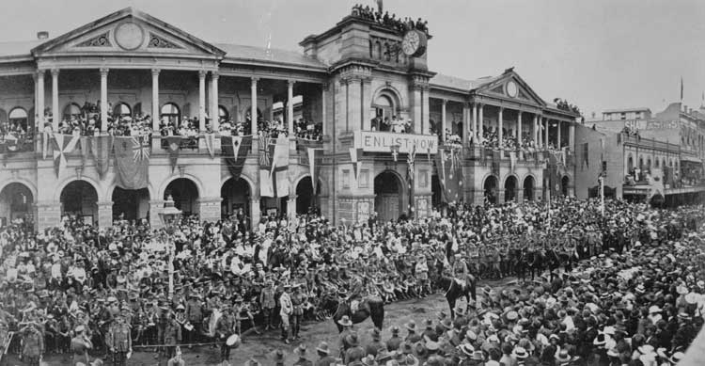
First anzac day march
April 25 1916 in Brisbane
Notes:
First ANZAC Day March Brisbane 25 April, 1916 National Archives of Australia Ref J2879, QTH173, http://vrroom.naa.gov.au/print/?ID=19356

Slide 11
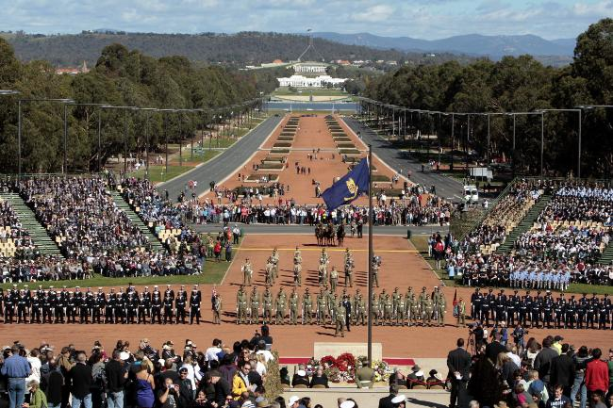
Anzac day canberra
Notes:
http://australiahistoryblog.blogspot.com.au/

Slide 12
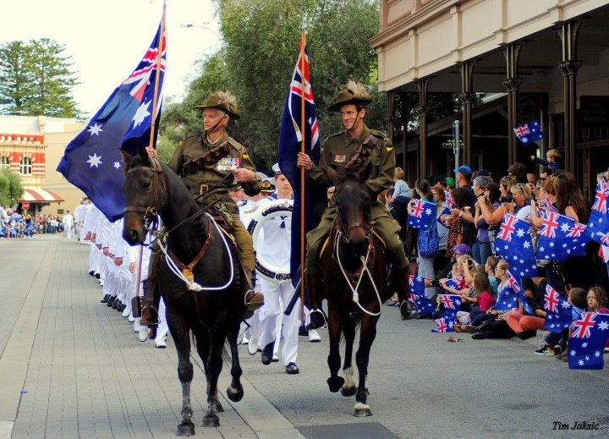
Anzac day march
Notes:
https://crystalmarylindsey.blogspot.com.au/2012/05/do-you-ever-have-times-when-you-cant.html

